Slide 1
Agent Technology Lecture 06
Markov decision process, reinforcement learning

Slide 2
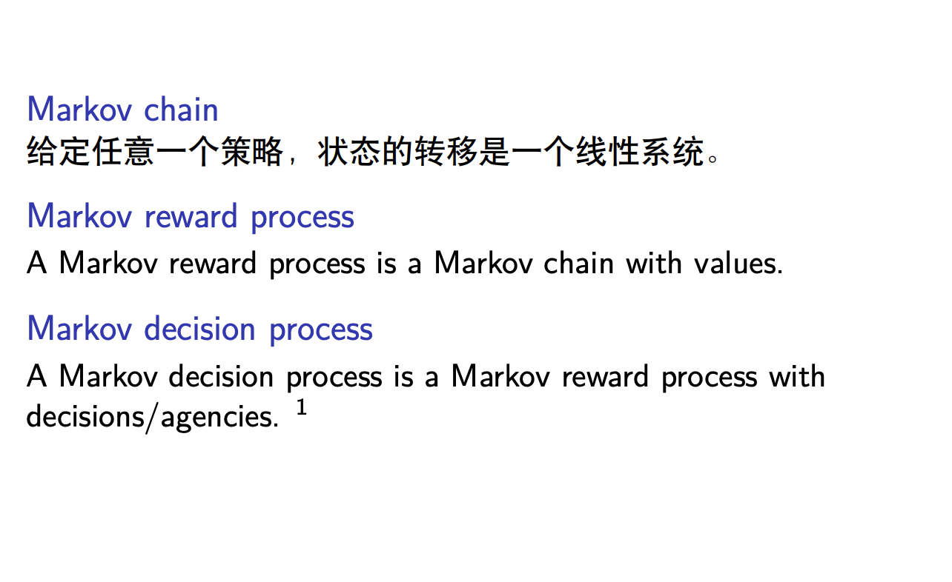
Markov decision process

Slide 3
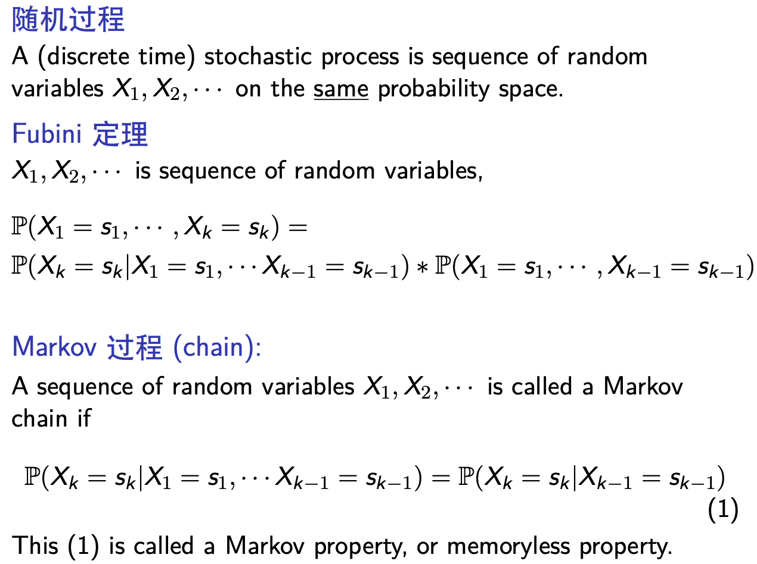
Markov chain

Slide 4
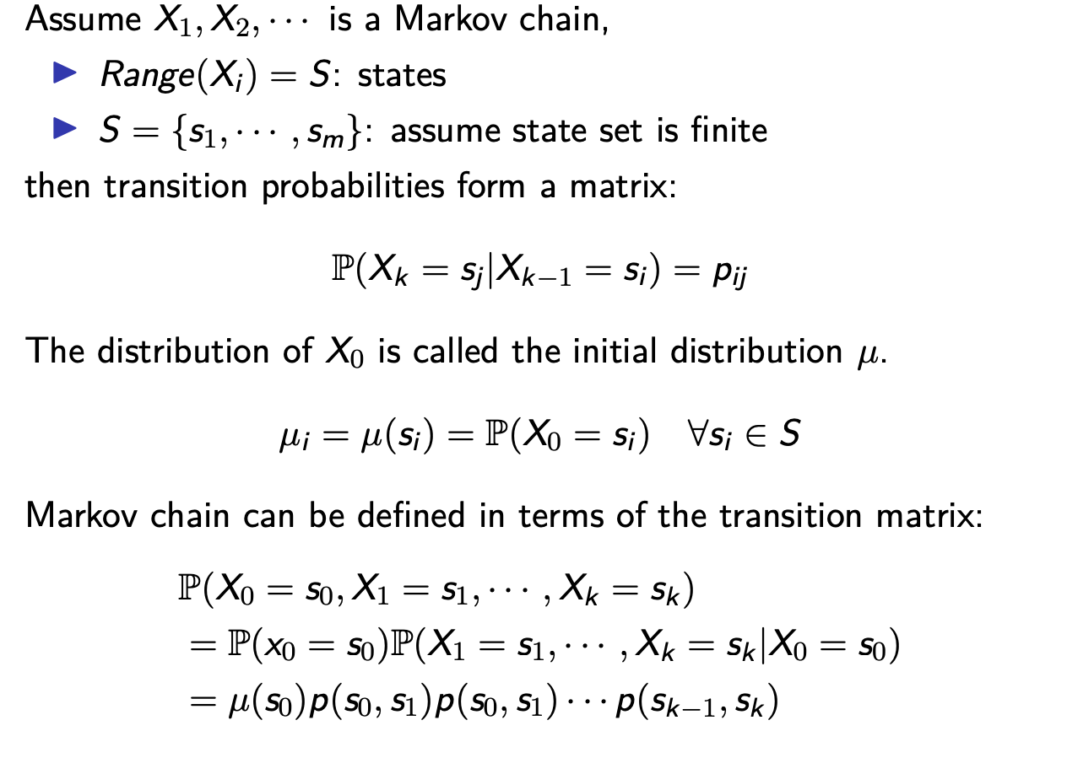
finite state Markov chains

Slide 5
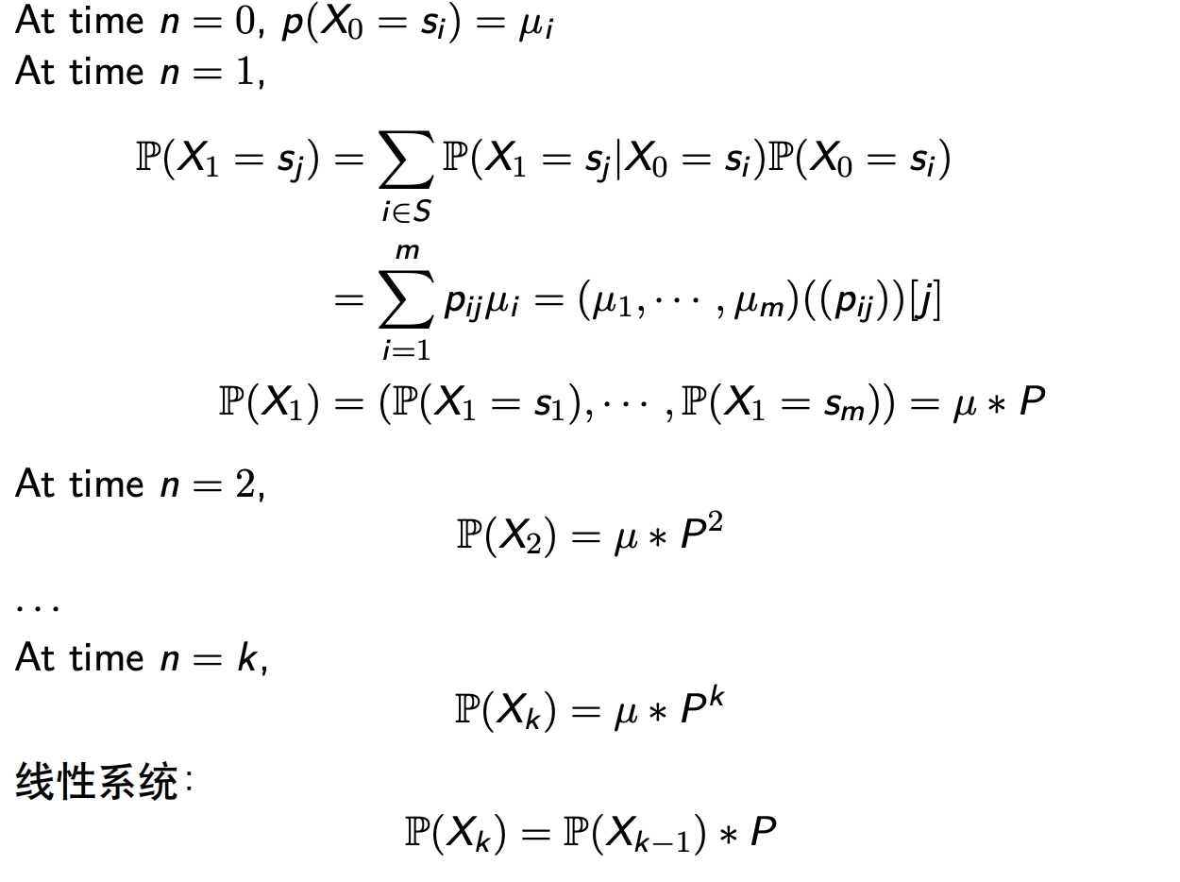
Markov chain: n-step transition probabilities

Slide 6
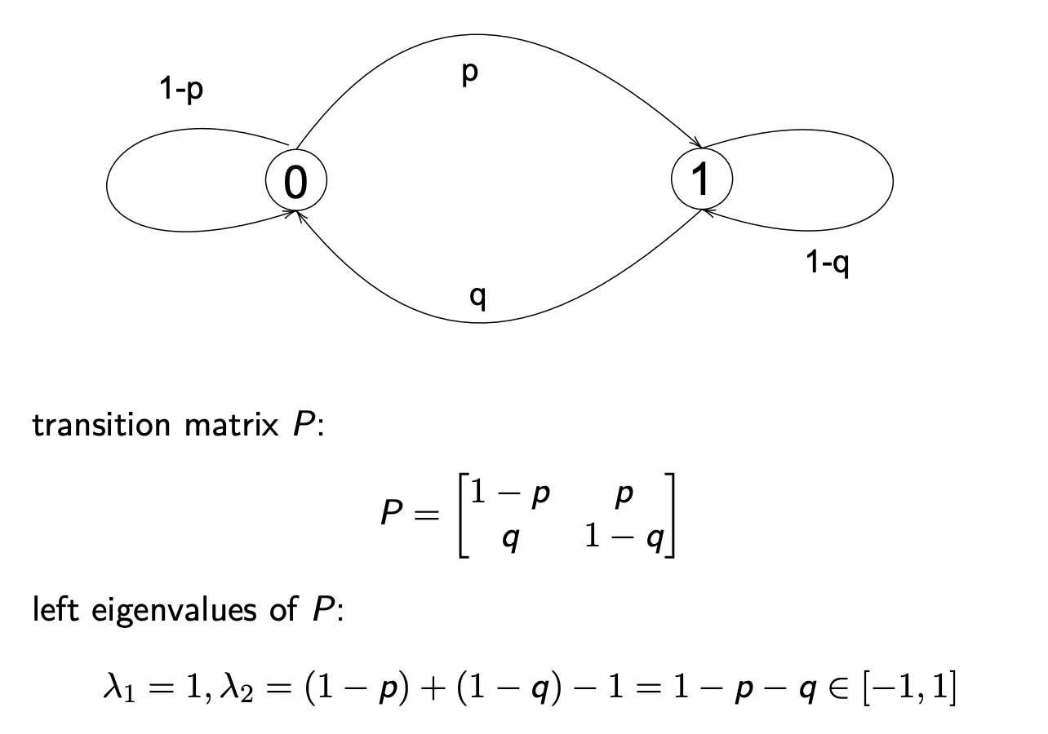
Markov chain: example 1

Slide 7
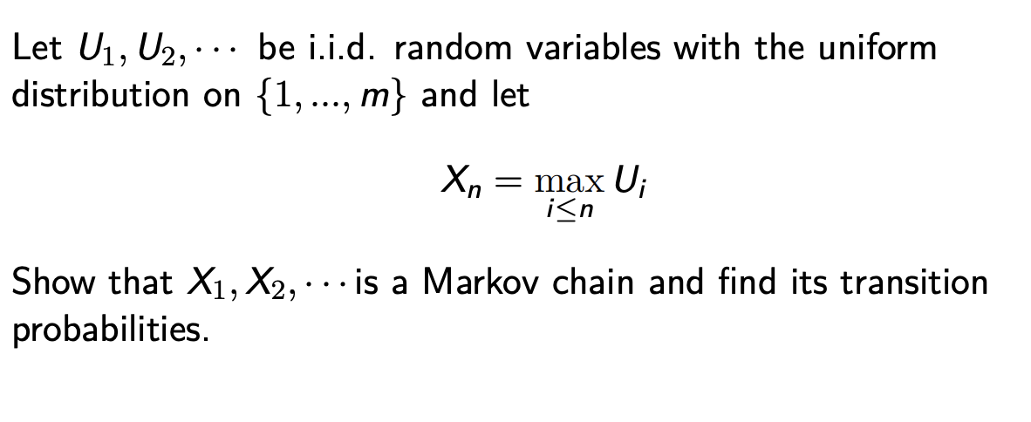
Markov chain: example 2

Slide 8
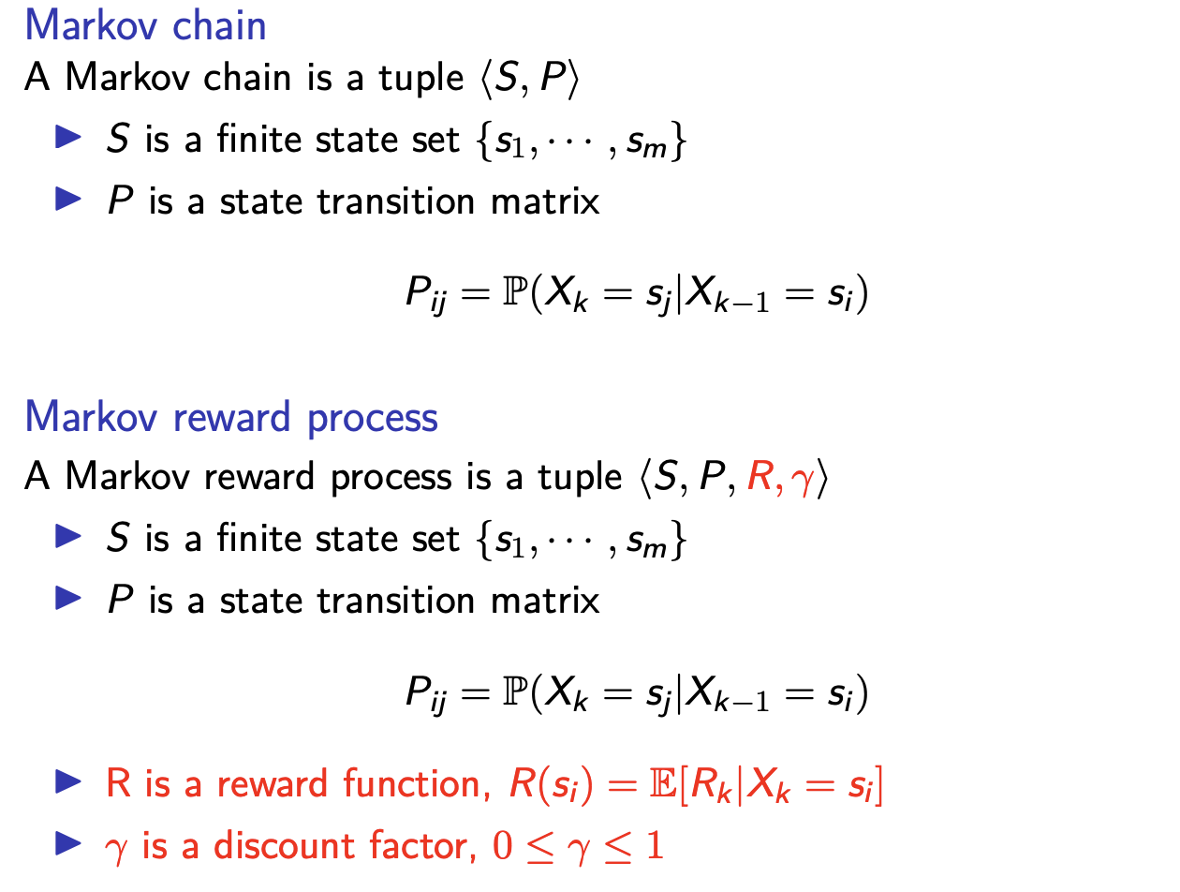
Markov reward process

Slide 9
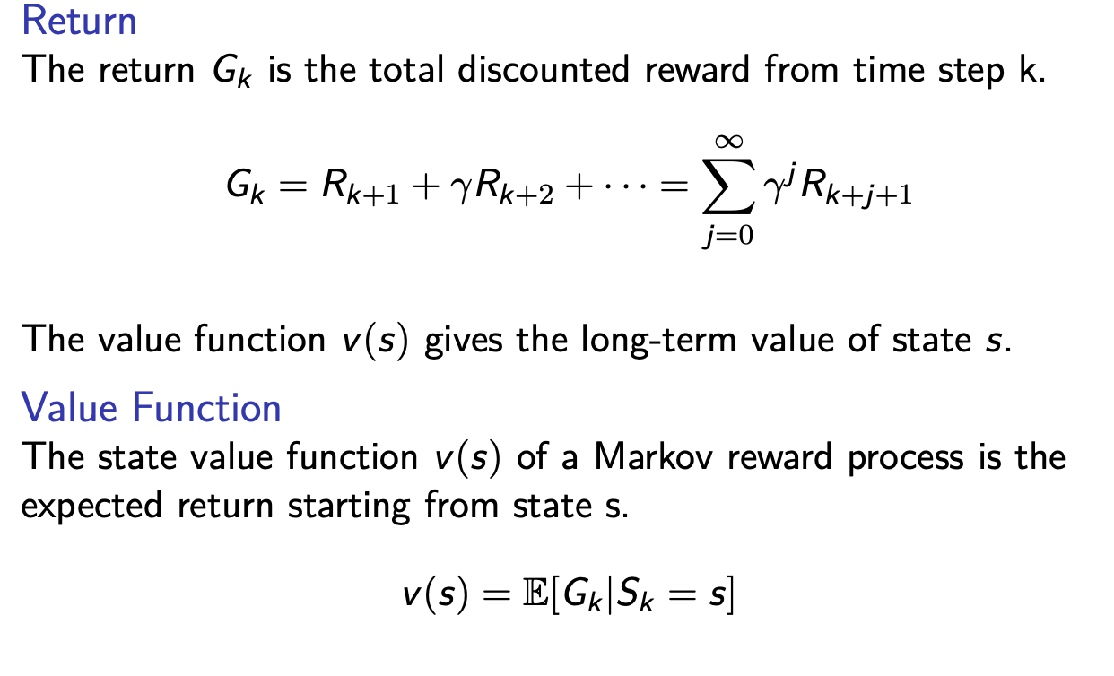
Markov reward process

Slide 10
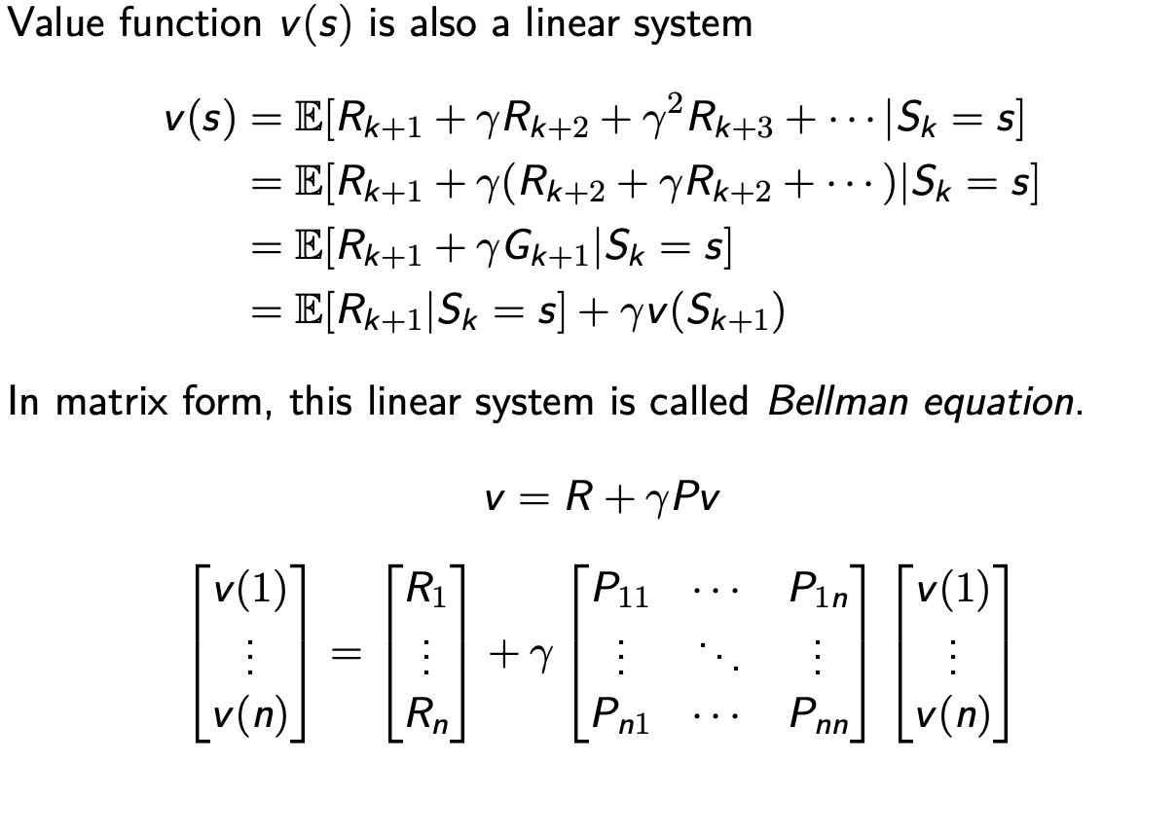
Markov reward process

Slide 11
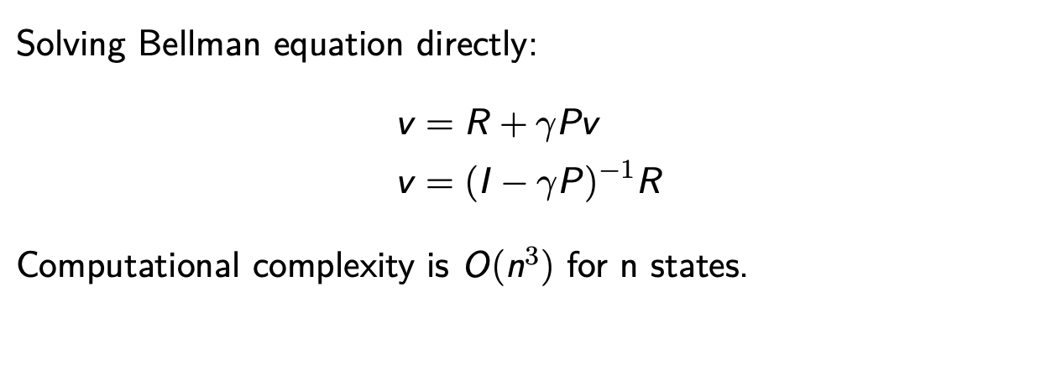
Markov reward process

Slide 12
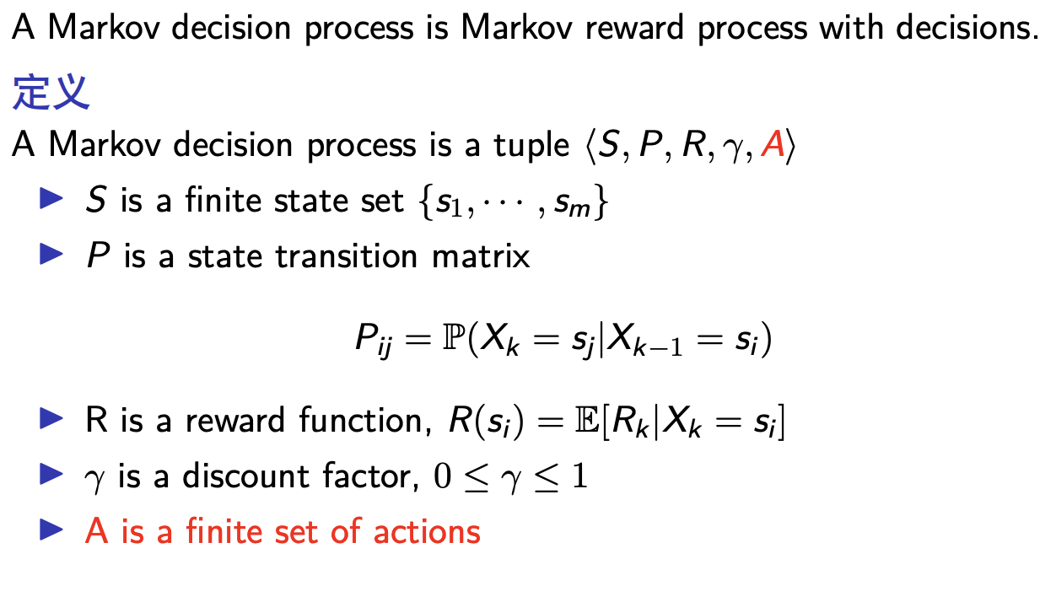
Markov decision process

Slide 13
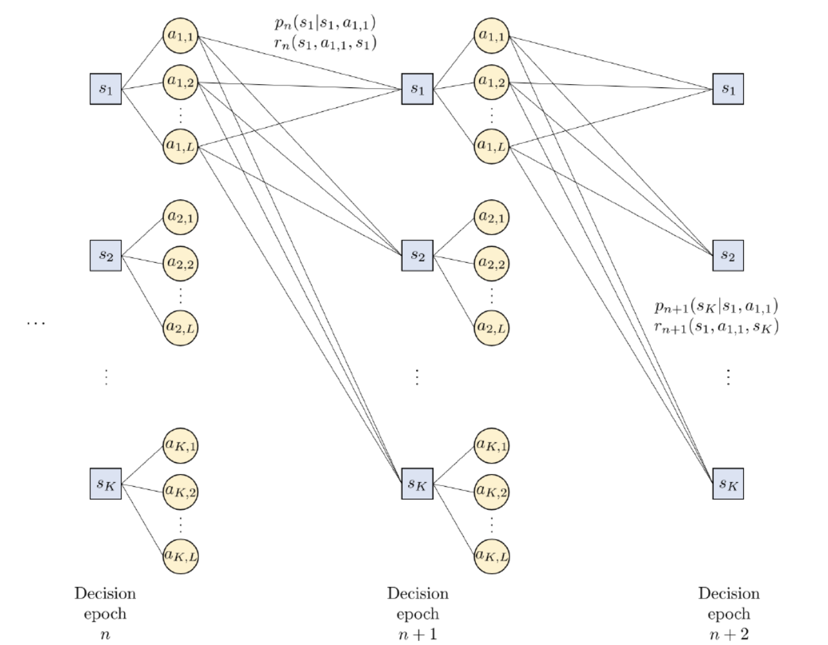
Representing a MDP by a decision tree

Slide 14
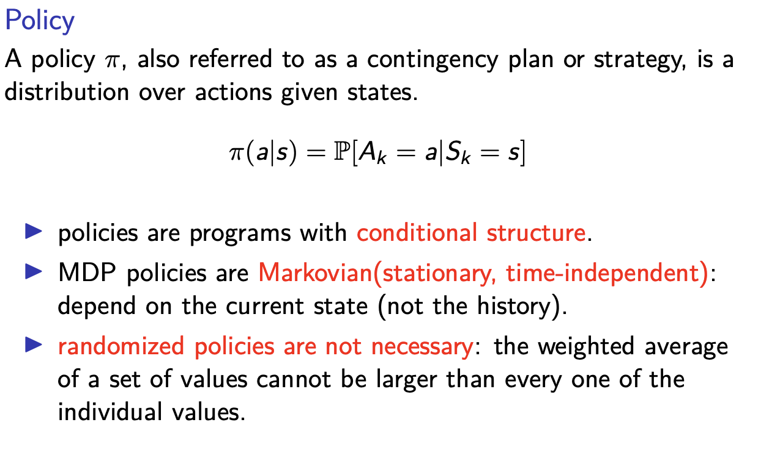
Markov decision process

Slide 15
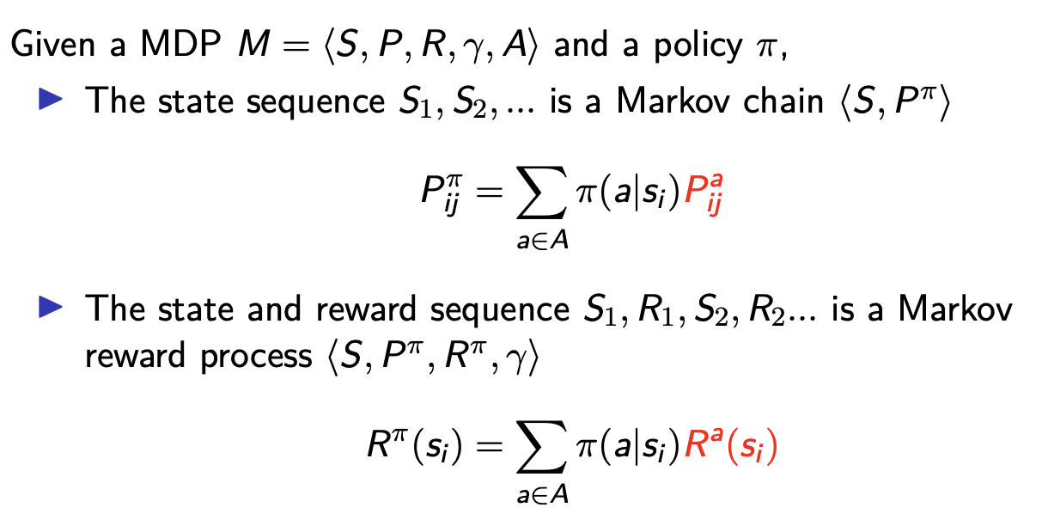
Derived Stochastic Processes

Slide 16
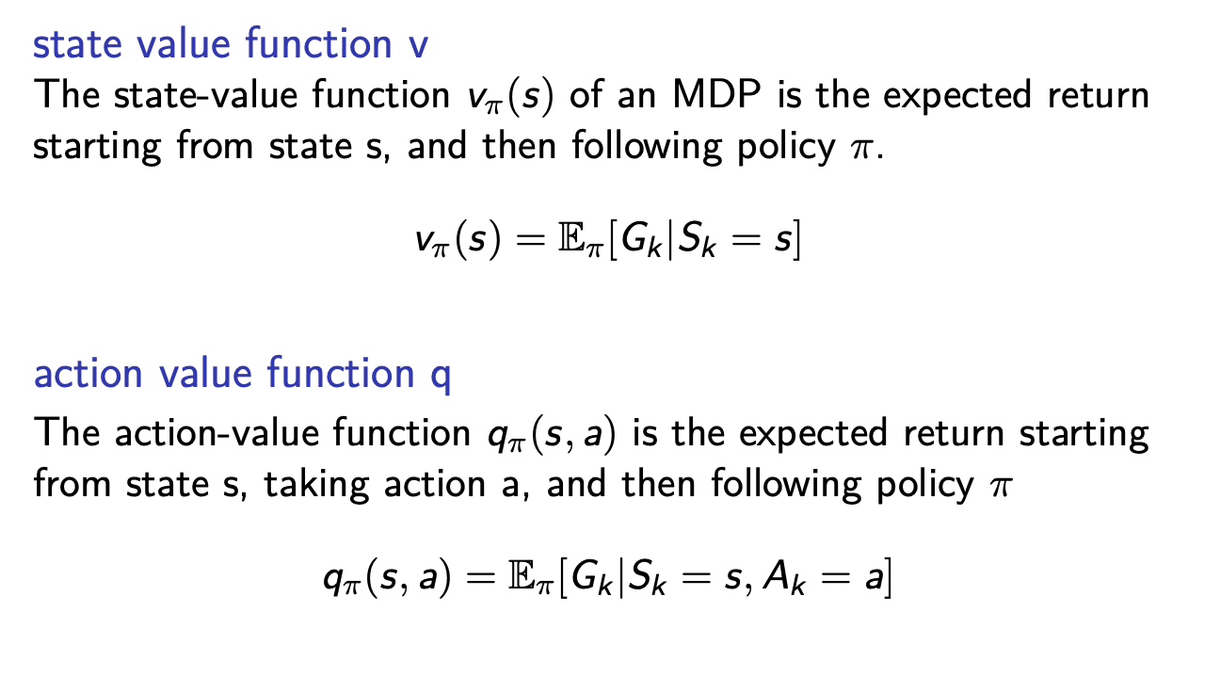
Value Function

Slide 17
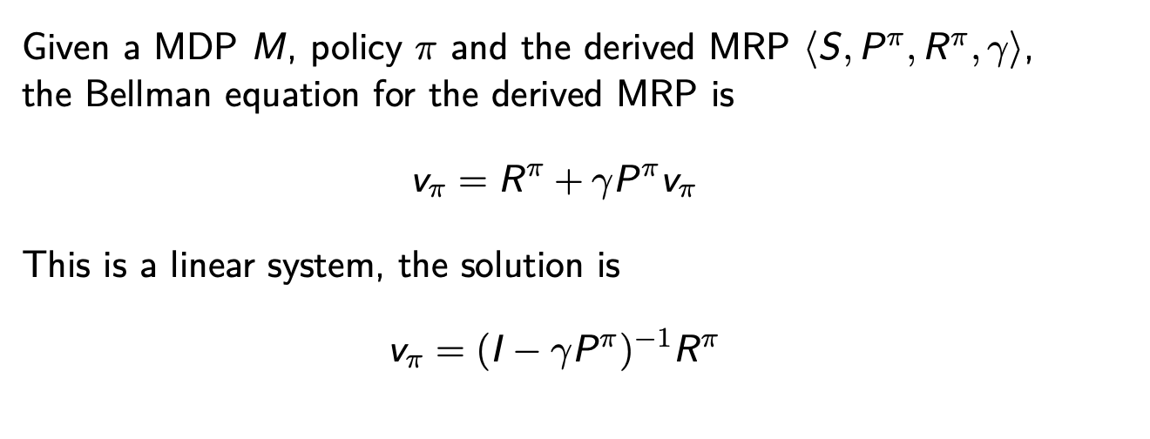
Bellman Equation (Matrix Form)

Slide 18
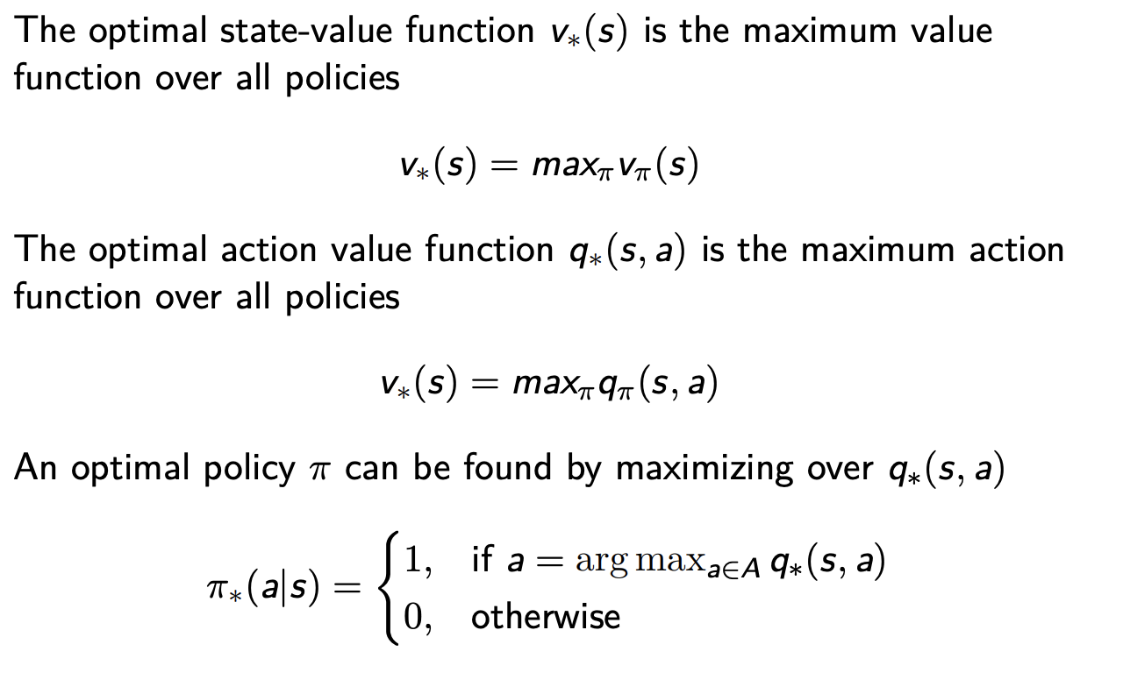
Optimal Value Function

Slide 19
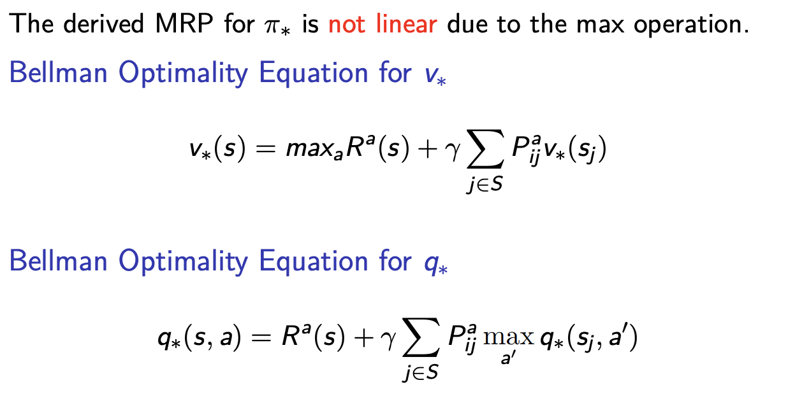
Bellman Optimality Equation

Slide 20
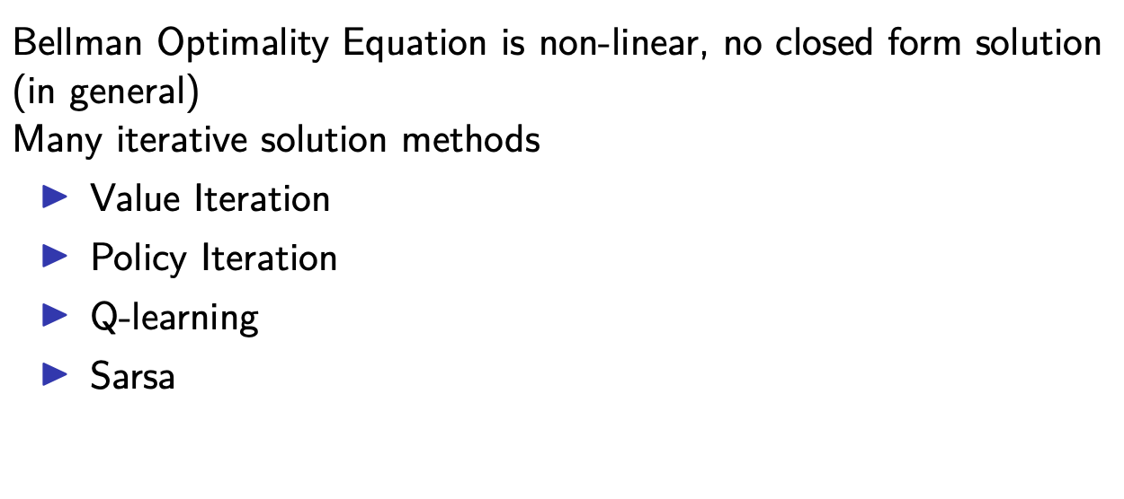
Solving the Bellman Optimality Equation

Slide 21
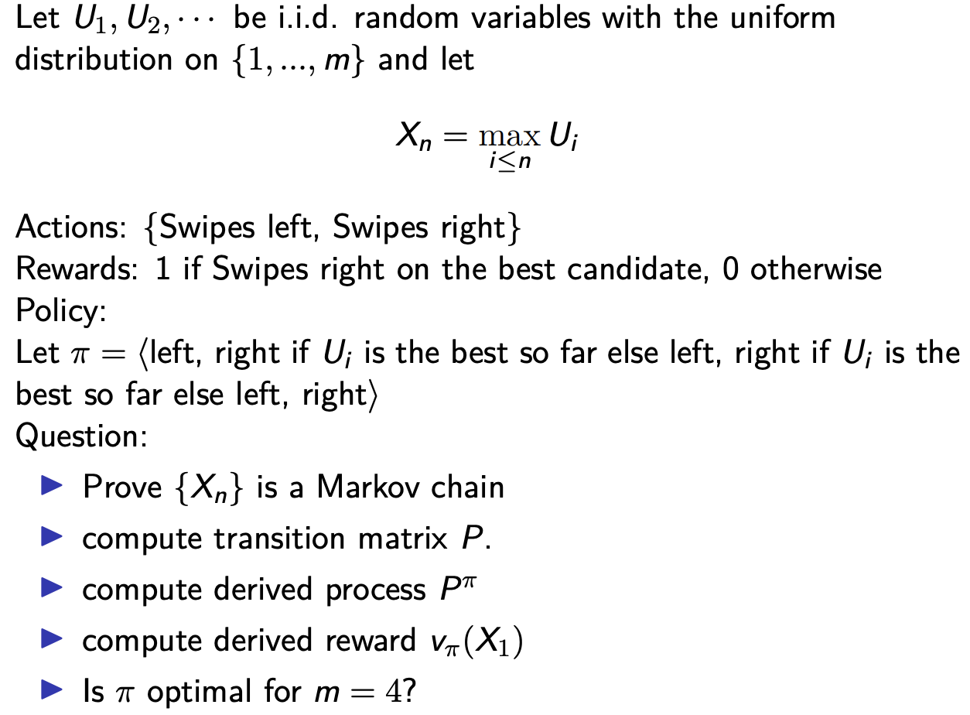
Example: online dating problem

Slide 22
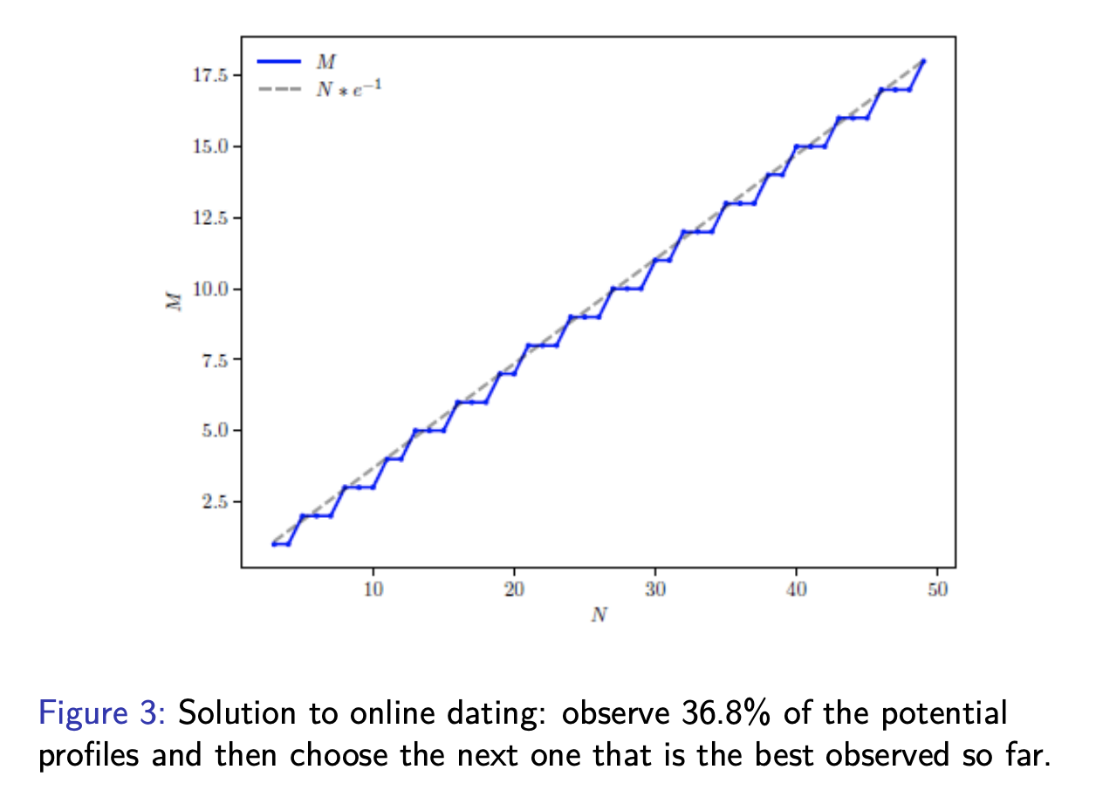
Example: online dating problem

Slide 23
















Reinforcement learning (RL)
Reinforcement learning
Model-based methods
Model-free methods
Value-based methods
Policy-based methods

Slide 24
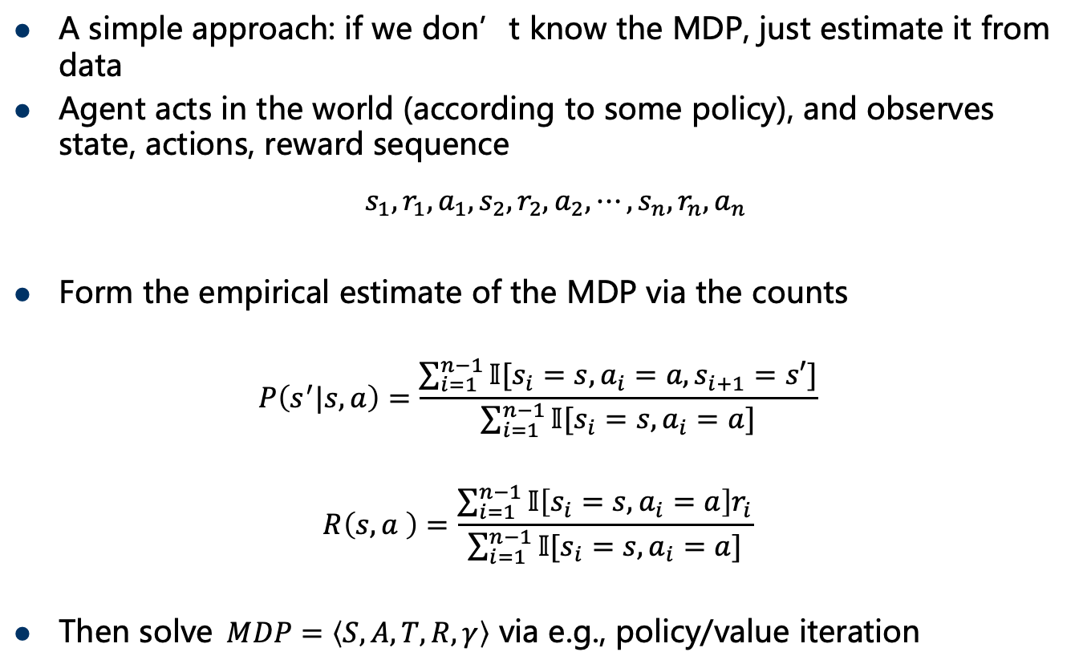
Model-based RL
A simple approach: if we don’t know the MDP, just estimate it from data
Agent acts in the world (according to some policy), and observes state, actions, reward sequence
$s_{1},r_{1},a_{1}, s_{2},r_{2},a_{2},⋯,s_{n},r_{n},a_{n}$
Form the empirical estimate of the MDP via the counts
$$P\left(s^{′}|s,a\right)=\frac{\sum_{i=1}^{n−1}{𝕀[s_{i}=s,a_{i}=a,s_{i+1}=s′]}}{\sum_{i=1}^{n−1}{𝕀[s_{i}=s,a_{i}=a]}}$$
$$R\left(s,a \right)=\frac{\sum_{i=1}^{n−1}{𝕀\left[s_{i}=s,a_{i}=a\right]r_{i}}}{\sum_{i=1}^{n−1}{𝕀[s_{i}=s,a_{i}=a]}}$$
Then solve$MDP=\left\langle S,A,T,R,γ\right\rangle$ via e.g., policy/value iteration

Slide 25
Model-based RL
Will converge to the correct MDP (and hence correct optimal value function / optimal policy) given enough samples of each state
How do we ensure that we get the “right” samples? (a challenging problem for all the methods we present here, stay tuned)
Advantages (informally) of model-based RL: makes “efficient” use of data
Disadvantages: requires we build the actual MDP models, solve for optimal policy (not much help if state space is too large)

Slide 26
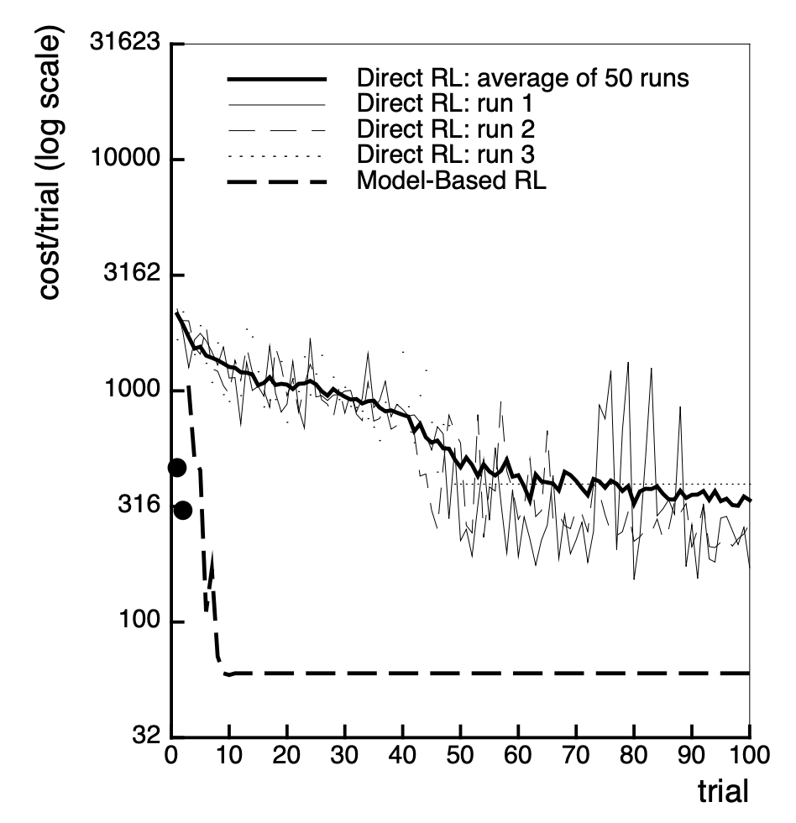
Performance of model-based RL
Atkeson and Santamaría, 96

Slide 27
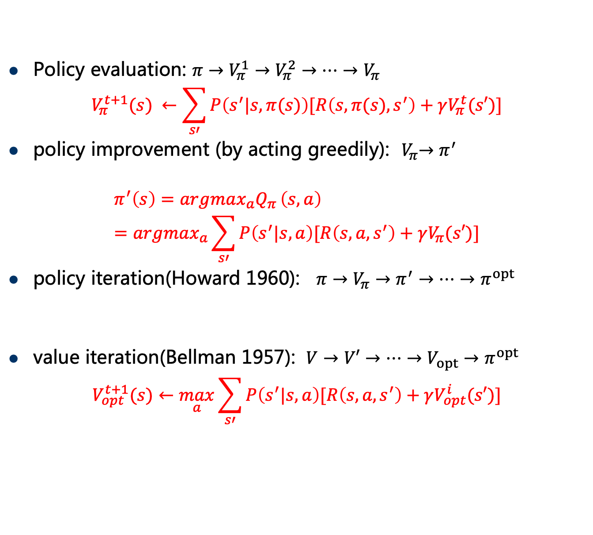
MDP planning by dynamic programming
Policy evaluation: $π→V_{π}^{1}→V_{π}^{2}→…→V_{π}$
$$V_{π}^{t+1}(s) ←\sum_{s′}{P\left(s^{′}|s,π(s)\right)[R\left(s,π(s),s^{′}\right)+γV_{π}^{t}(s′)]}$$
policy improvement (by acting greedily):${ V}_{π}→π^{′}$
$$π^{′}\left(s\right)=argmax_{a}Q_{π }\left(s,a\right) =argmax_{a}\sum_{s′}{P\left(s^{′}|s,a\right)[R\left(s,a,s^{′}\right)+γV_{π}(s′)]}$$
policy iteration(Howard 1960): $π→V_{π}→π^{′}→…→π^{opt}$
value iteration(Bellman 1957): $V→V′→…→V_{opt}→π^{opt}$
$$V_{opt}^{t+1}(s)←\max_{a}{\sum_{s′}{P\left(s^{′}|s,a\right)[R\left(s,a,s^{′}\right)+γV_{opt}^{i}(s′)]}}$$
𝑤ℎ𝑖𝑙𝑒(--$t_{pi}$) { 𝑝𝑜𝑙𝑖𝑐𝑦_𝑒𝑣𝑎𝑙𝑢𝑎𝑡𝑖𝑜𝑛(); 𝑝𝑜𝑙𝑖𝑐𝑦_𝑖𝑚𝑝𝑟𝑜𝑣𝑒𝑚𝑒𝑛𝑡 (); }
Notes:
how do we compute these quantities when T and R are unknown?

Slide 28
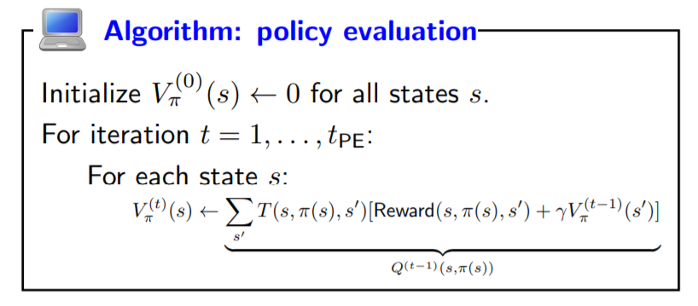

Policy evaluation $π→V_{π}$
Start with arbitrary policy values and repeatedly apply recurrences to converge to true values.

Slide 29
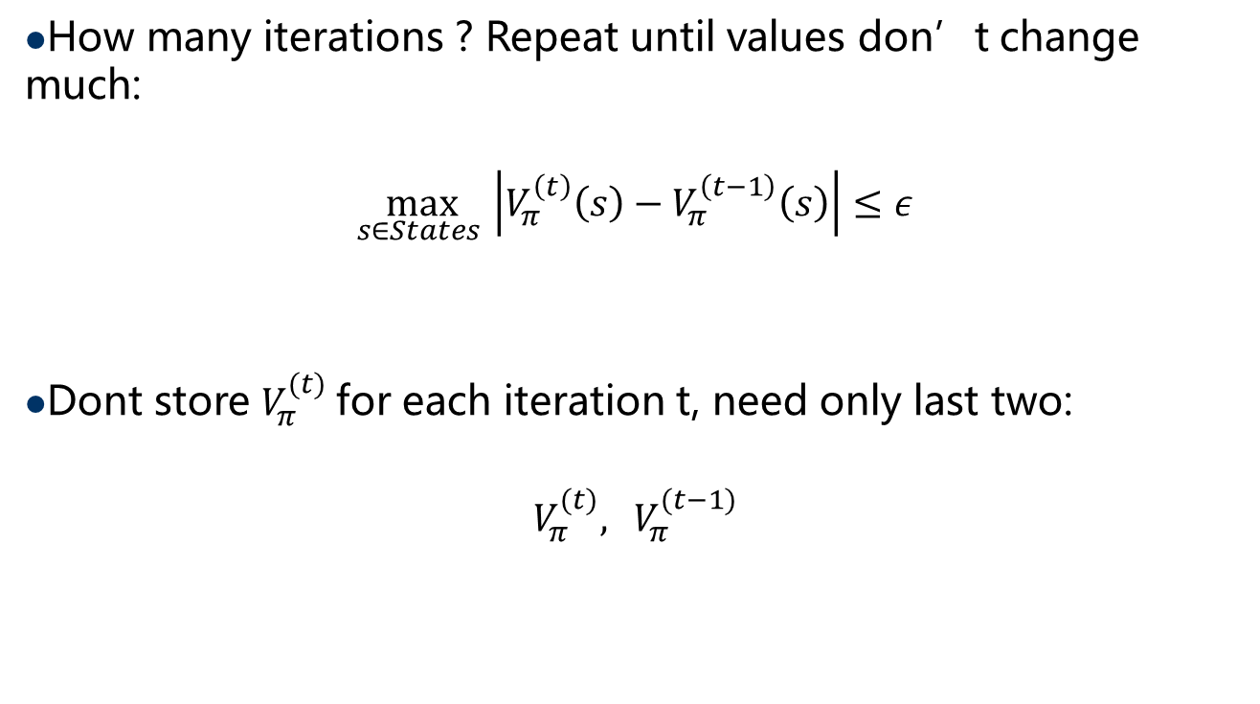
Policy evaluation implementation
How many iterations ? Repeat until values don’t change much:
$$\max_{s∈States }\left|V_{π}^{\left(t\right)}\left(s\right)−V_{π}^{\left(t−1\right)}\left(s\right)\right|≤ε$$
Dont store $V_{π}^{(t)}$for each iteration t, need only last two:
$$V_{π}^{(t)},{ V}_{π}^{(t−1)}$$

Slide 30
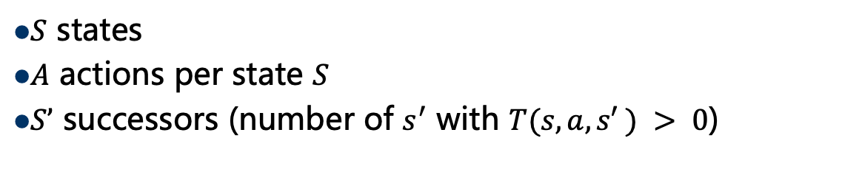
Policy Evaluation Time Complexity $O\left(t_{PE}SS’\right)$
$S$ states
$A$ actions per state $S$
$S’$ successors (number of $s^{′}$ with $T(s, a, s′ ) > 0$)

Slide 31
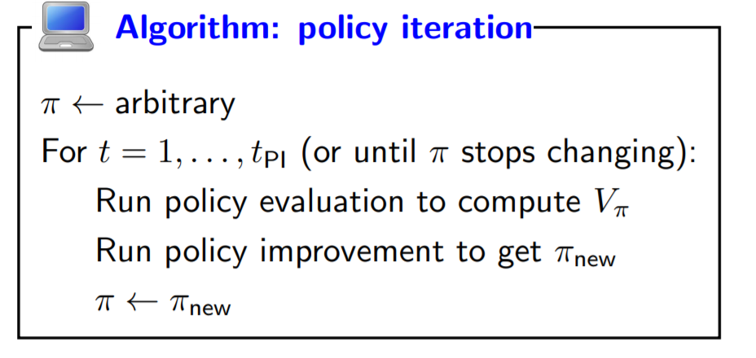

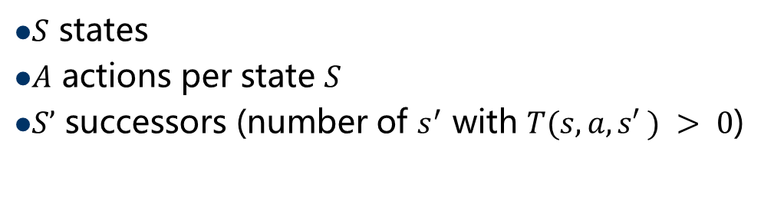
Policy iteration $π^{ random}→π^{ optimal}$
$S$ states
$A$ actions per state $S$
$S’$ successors (number of $s^{′}$ with $T(s, a, s′ ) > 0$)
Time Complexity $O\left({t_{PI}(t}_{PE}SS’+SAS′)\right)$

Slide 32
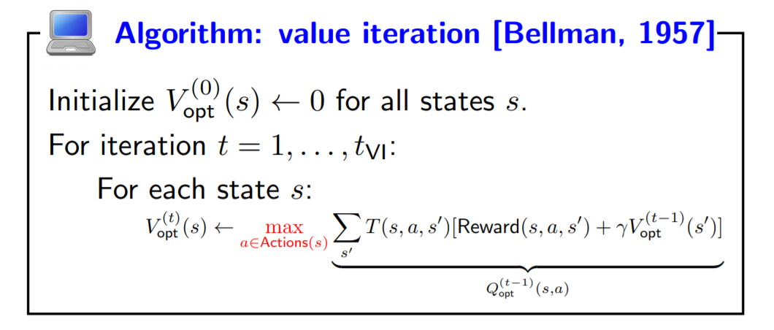

Value Iteration Time Complexity $O\left(t_{VI}SAS′\right)$
$S$ states
$A$ actions per state $S$
$S’$ successors (number of $s^{′}$ with $T(s, a, s′ ) > 0$)

Slide 33
Planning by dynamic programming
Policy evaluation: $π→V_{π}^{1}→V_{π}^{2}→…→V_{π}$
$$V_{π}^{t+1}(s) ←\sum_{s′}{P\left(s^{′}|s,π(s)\right)[R\left(s,π(s),s^{′}\right)+γV_{π}^{t}(s′)]}$$
policy improvement (by acting greedily):${ V}_{π}→π^{′}$
$$π^{′}\left(s\right)=argmax_{a}Q_{π }\left(s,a\right) =argmax_{a}\sum_{s′}{P\left(s^{′}|s,a\right)[R\left(s,a,s^{′}\right)+γV_{π}(s′)]}$$
policy iteration(Howard 1960): $π→V_{π}→π^{′}→…→π^{opt}$
value iteration(Bellman 1957): $V→V′→…→V_{opt}→π^{opt}$
$$V_{opt}^{t+1}(s)←\max_{a}{\sum_{s′}{P\left(s^{′}|s,a\right)[R\left(s,a,s^{′}\right)+γV_{opt}^{i}(s′)]}}$$
𝑤ℎ𝑖𝑙𝑒(--$t_{pi}$) { 𝑝𝑜𝑙𝑖𝑐𝑦_𝑒𝑣𝑎𝑙𝑢𝑎𝑡𝑖𝑜𝑛(); 𝑝𝑜𝑙𝑖𝑐𝑦_𝑖𝑚𝑝𝑟𝑜𝑣𝑒𝑚𝑒𝑛𝑡 (); }
Notes:
how do we compute these quantities when T and R are unknown?

Slide 34


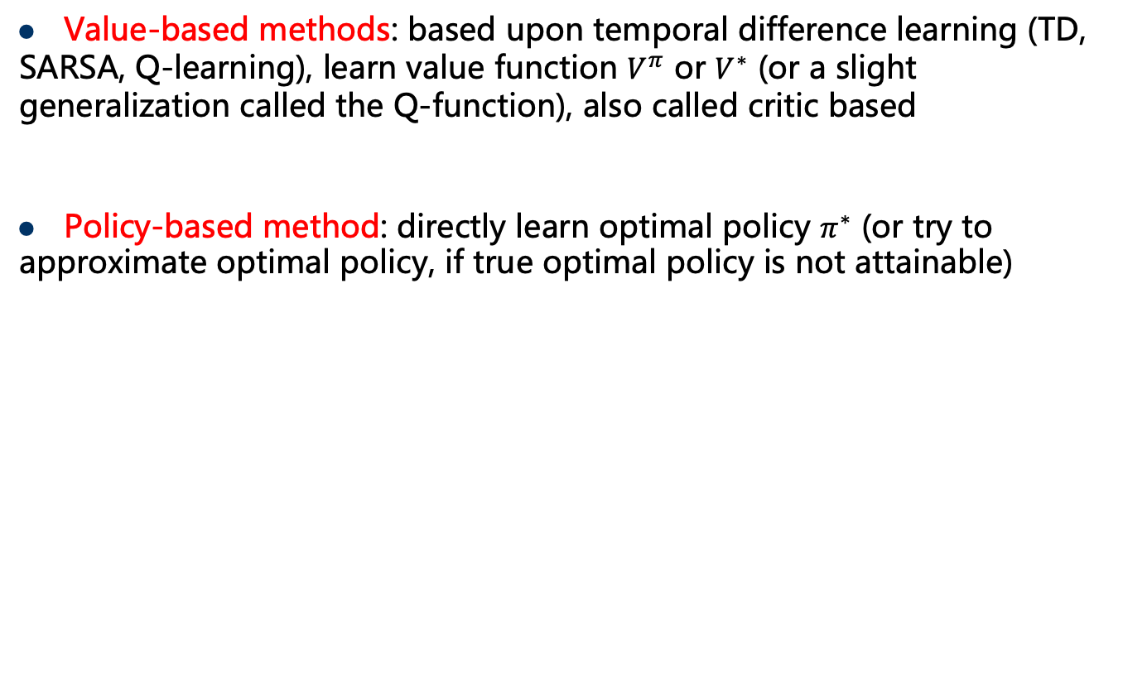
Model-free methods
Value-based methods: based upon temporal difference learning (TD, SARSA, Q-learning), learn value function $V^{π}$ or $V^{∗}$ (or a slight generalization called the Q-function), also called critic based
Policy-based method: directly learn optimal policy $π^{∗}$ (or try to approximate optimal policy, if true optimal policy is not attainable)
Reinforcement learning
Model-based methods
Model-free methods
Value-based methods
Policy-based methods

Slide 35
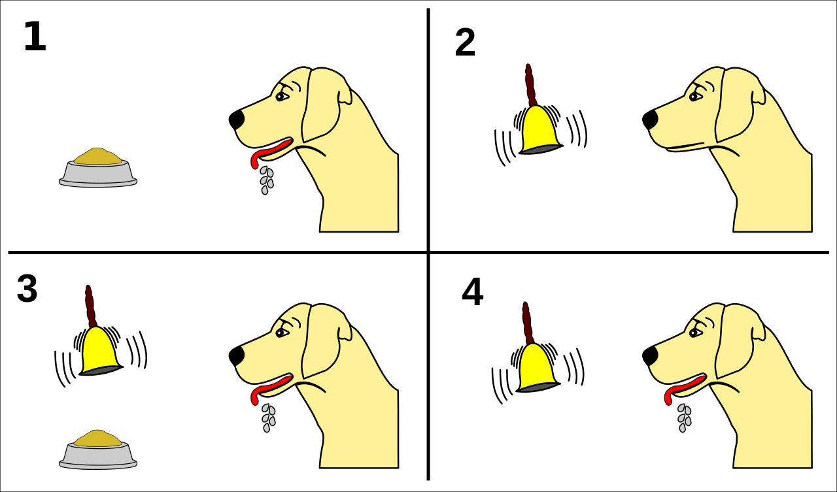
Temporal difference learning
Classic theories assume that learning occurs whenever a stimulus is paired with a reward or punishment.

Slide 36
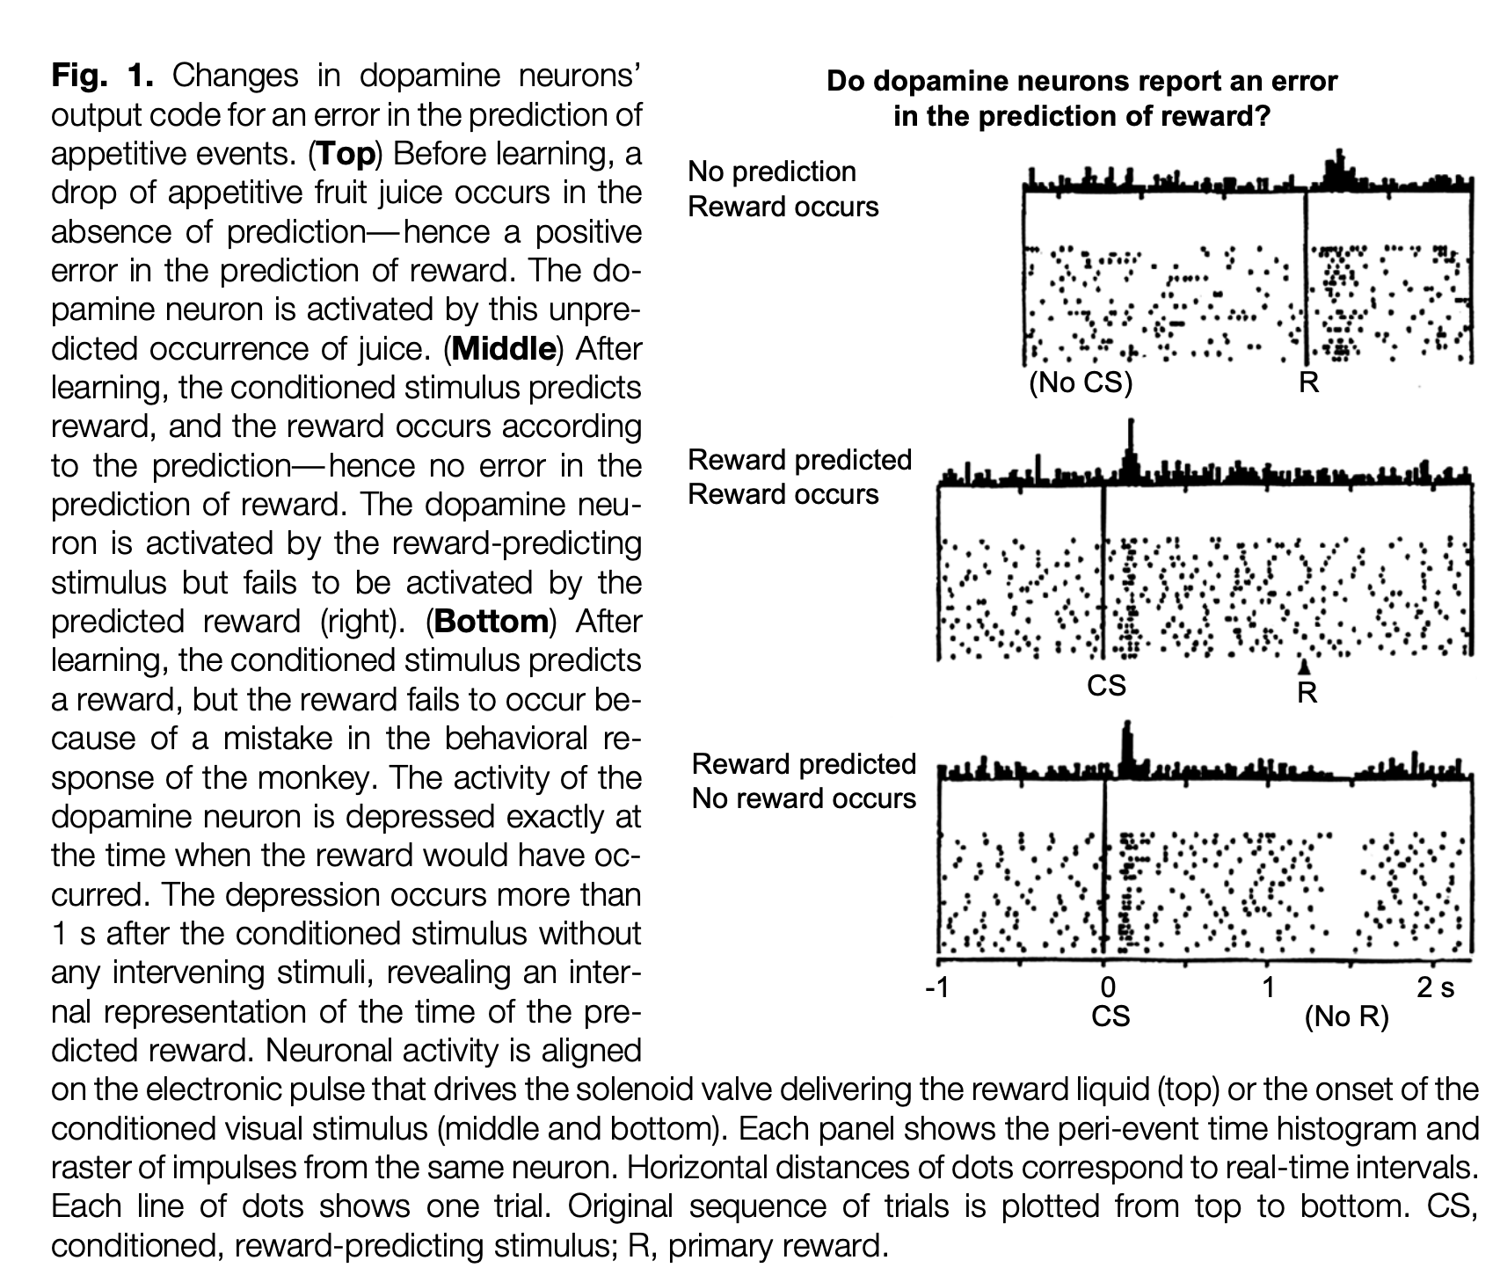
A Neural Substrate of Prediction and Reward

Slide 37
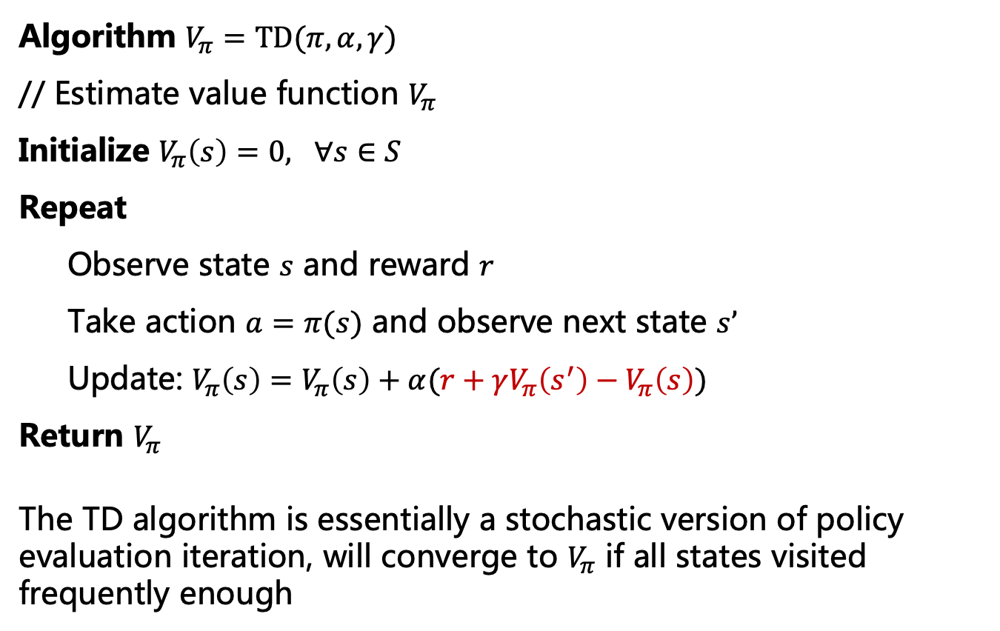
Temporal difference (TD) methods
Algorithm $V_{π}=TD(π,α,γ)$
// Estimate value function $V_{π}$
Initialize $V_{π}\left(s\right)=0, ∀s∈S$
Repeat
Observe state $s$ and reward $r$
Take action $a=π(s)$ and observe next state $s’$
Update: $V_{π}\left(s\right)=V_{π}\left(s\right)+α(r+γV_{π}\left(s^{′}\right)−V_{π}\left(s\right))$
Return $V_{π}$
The TD algorithm is essentially a stochastic version of policy evaluation iteration, will converge to $V_{π}$ if all states visited frequently enough

Slide 38
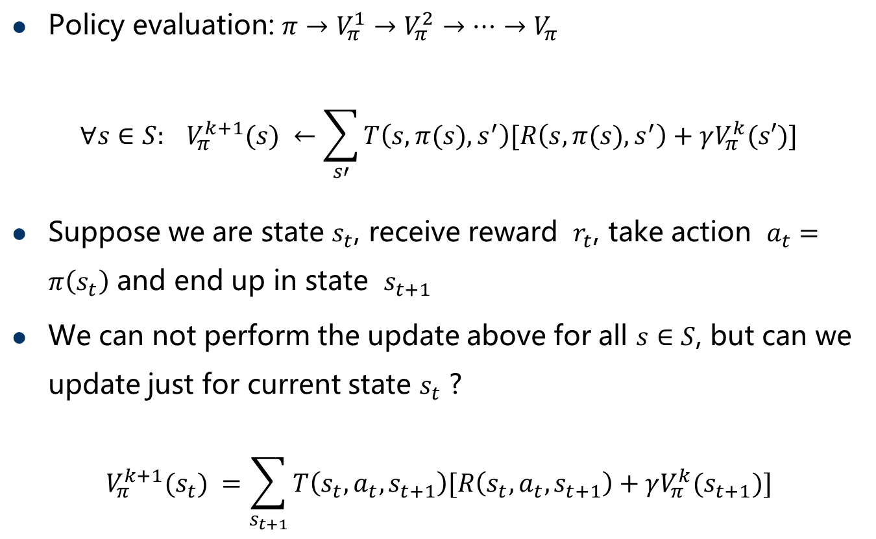
Value/critic based RL methods
Policy evaluation: $π→V_{π}^{1}→V_{π}^{2}→…→V_{π}$
$${ ∀s∈S: V}_{π}^{k+1}(s) ←\sum_{s′}{T\left(s,π(s),s^{′}\right)[R\left(s,π(s),s^{′}\right)+γV_{π}^{k}(s′)]}$$
Suppose we are state $s_{t}$, receive reward $r_{t}$, take action $a_{t}=π\left(s_{t}\right)$ and end up in state $s_{t+1}$
We can not perform the update above for all $s∈S$, but can we update just for current state $s_{t}$ ?
$${ V}_{π}^{k+1}(s_{t}) =\sum_{s_{t+1}}{T\left(s_{t},a_{t},s_{t+1}\right)[R\left(s_{t},a_{t},s_{t+1}\right)+γV_{π}^{k}(s_{t+1})]}$$

Slide 39
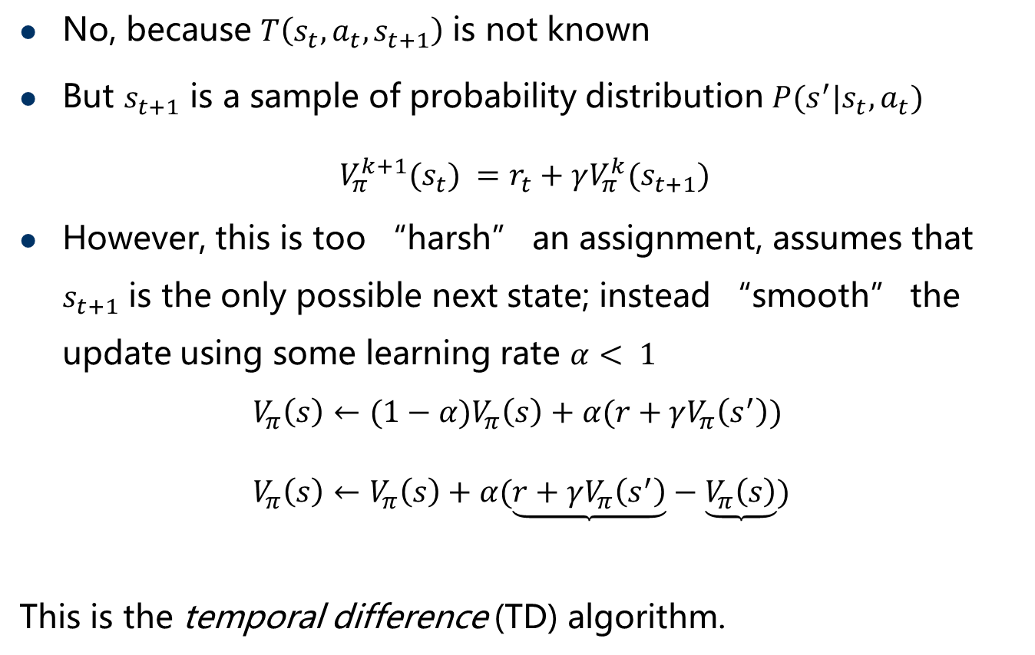
Temporal difference (TD) methods
No, because $T\left(s_{t},a_{t},s_{t+1}\right)$ is not known
But $s_{t+1}$ is a sample of probability distribution $P(s^{′}|s_{t},a_{t})$
$${ V}_{π}^{k+1}(s_{t}) =r_{t}+γV_{π}^{k}(s_{t+1})$$
However, this is too “harsh” an assignment, assumes that $s_{t+1}$ is the only possible next state; instead “smooth” the update using some learning rate $α< 1$
$$V_{π}\left(s\right)←{(1−α)V}_{π}\left(s\right)+α(r+γV_{π}\left(s^{′}\right))$$
$$V_{π}\left(s\right)←V_{π}\left(s\right)+α(\underset{}{\underbrace{r+γV_{π}\left(s^{′}\right)}}−\underbrace{V_{π}\left(s\right)})$$
This is the temporal difference (TD) algorithm.
stochastic gradient view
TD target
prediction

Slide 40
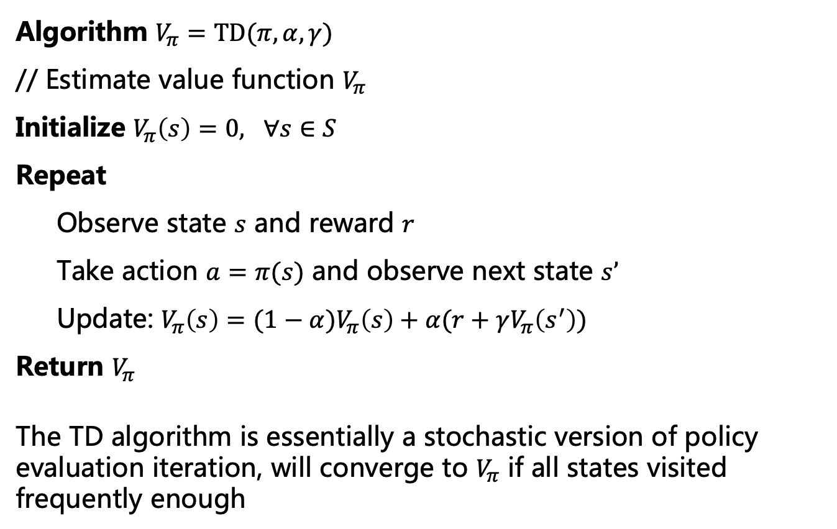
Temporal difference (TD) methods
Algorithm $V_{π}=TD(π,α,γ)$
// Estimate value function $V_{π}$
Initialize $V_{π}\left(s\right)=0, ∀s∈S$
Repeat
Observe state $s$ and reward $r$
Take action $a=π(s)$ and observe next state $s’$
Update: $V_{π}\left(s\right)={(1−α)V}_{π}\left(s\right)+α(r+γV_{π}\left(s^{′}\right))$
Return $V_{π}$
The TD algorithm is essentially a stochastic version of policy evaluation iteration, will converge to $V_{π}$ if all states visited frequently enough

Slide 41
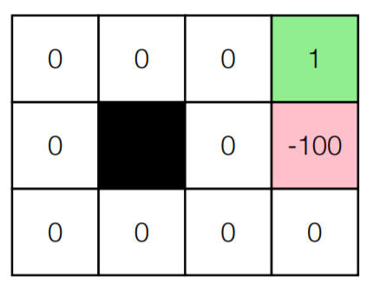
TD experiments
Run TD on grid world for 1000 episode (each episode consists of 10 steps, sampled according to a policy, starting at a random state), initialized with V(s)=R(s)

Slide 42
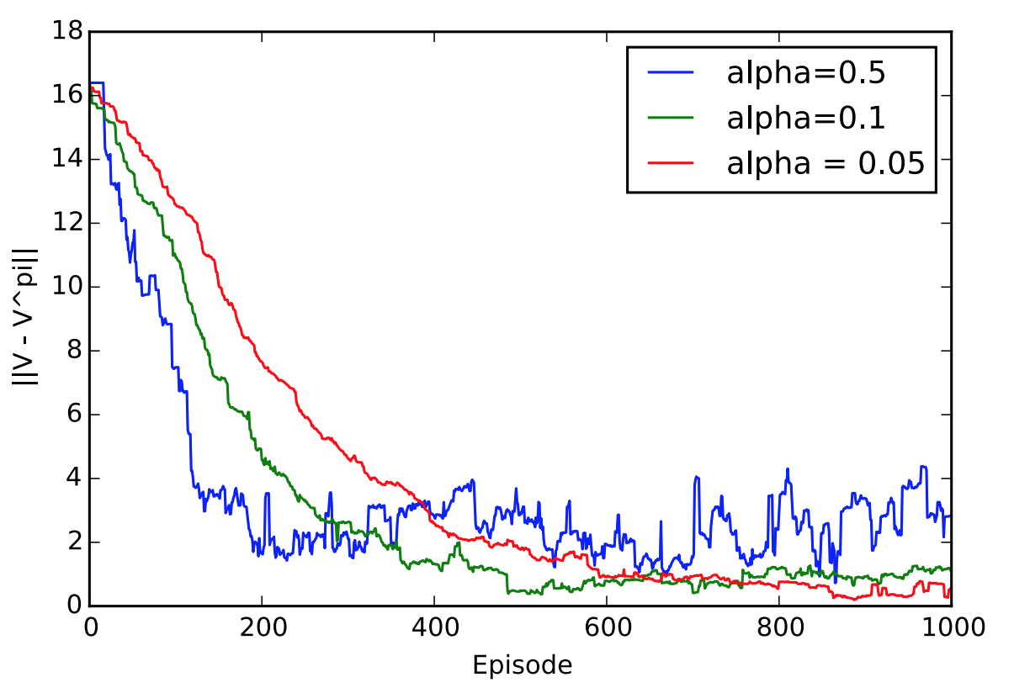
TD Progress
Value estimation error of TD for different $α$

Slide 43
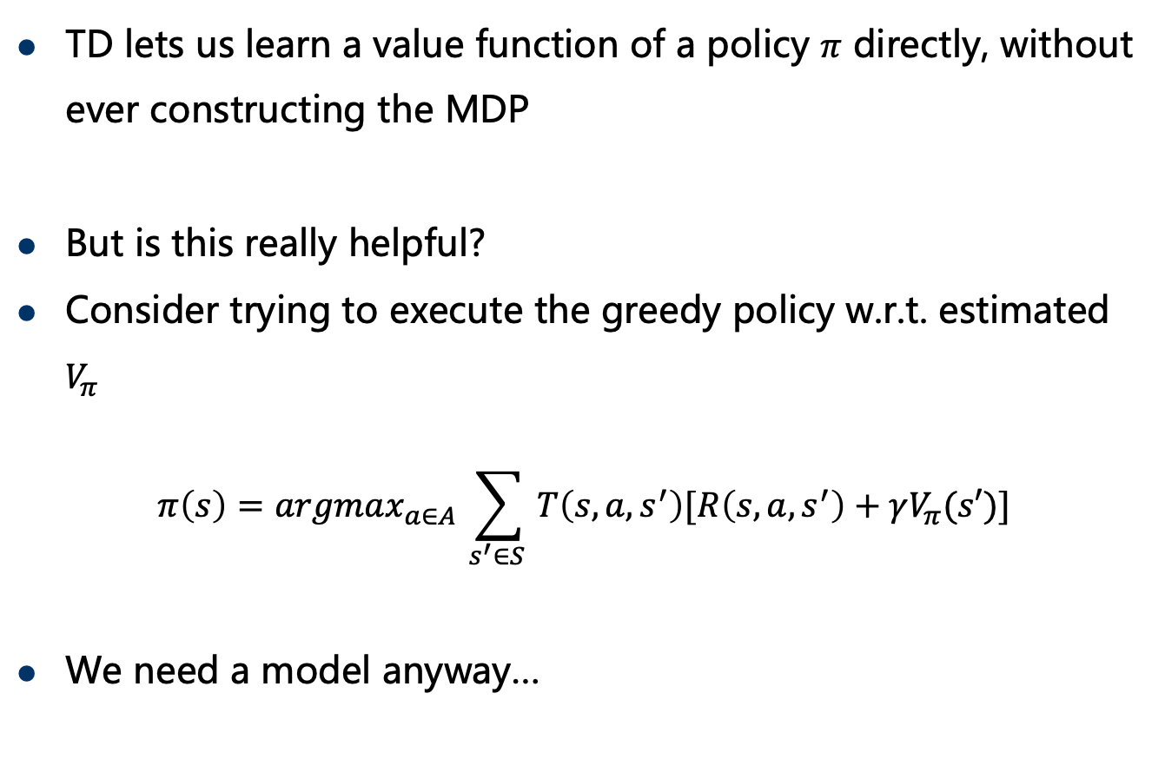
Issues with traditional TD algorithms
TD lets us learn a value function of a policy $π$ directly, without ever constructing the MDP
But is this really helpful?
Consider trying to execute the greedy policy w.r.t. estimated $V_{π}$
$$π\left(s\right)=argmax_{a∈A }\sum_{s^{′}∈S }{T\left(s,a,s^{′}\right)[R\left(s,a,s^{′}\right)+γV_{π}(s′)]}$$
We need a model anyway…

Slide 44
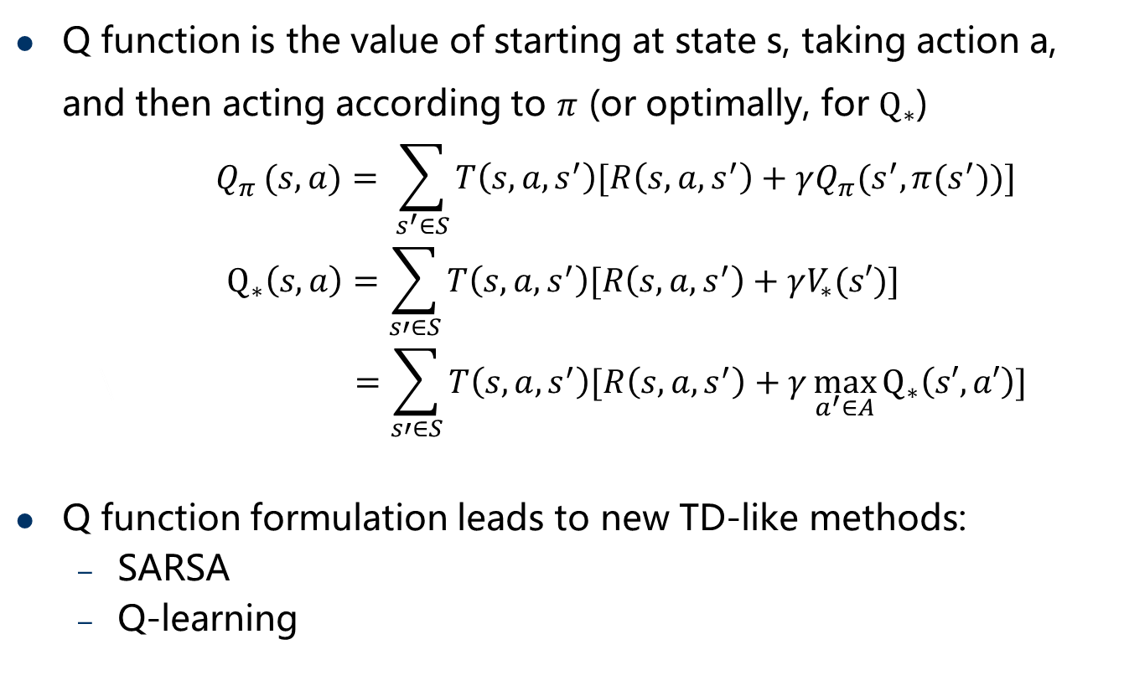
The Q value function
Q function is the value of starting at state s, taking action a, and then acting according to $π$ (or optimally, for $Q_{∗}$)
$${ Q}_{π }(s,a)= \sum_{s^{′}∈S}{T\left(s,a,s^{′}\right)[R\left(s,a,s^{′}\right)+γQ_{π}(s^{′},π(s^{′}))]}$$
$$Q_{∗}\left(s,a\right)=\sum_{s′∈S}{T\left(s,a,s^{′}\right)[R\left(s,a,s^{′}\right)+γV_{∗}(s′)]}$$
$$\backslash =\sum_{s′∈S}{T\left(s,a,s^{′}\right)[R\left(s,a,s^{′}\right)+γ\max_{a^{′}∈A}{Q_{∗}\left(s′,a′\right)}]}$$
Q function formulation leads to new TD-like methods:
SARSA
Q-learning

Slide 45
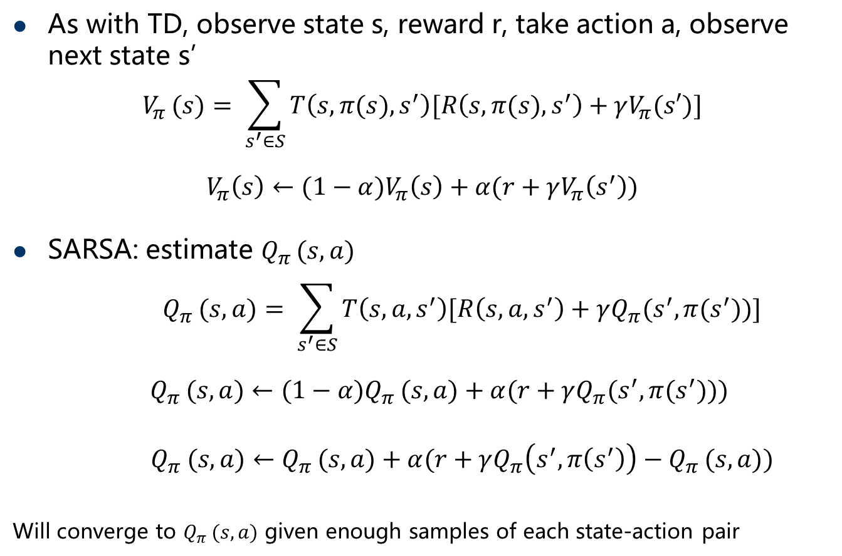
SARSA
As with TD, observe state s, reward r, take action a, observe next state s’
$$V_{π }(s)= \sum_{s^{′}∈S}{T\left(s,π(s),s^{′}\right)[R\left(s,π(s),s^{′}\right)+γV_{π}(s′)]}$$
$$V_{π}\left(s\right)←{(1−α)V}_{π}\left(s\right)+α(r+γV_{π}\left(s^{′}\right))$$
SARSA: estimate $Q_{π }(s,a)$
$${ Q}_{π }(s,a)= \sum_{s^{′}∈S}{T\left(s,a,s^{′}\right)[R\left(s,a,s^{′}\right)+γQ_{π}(s^{′},π(s^{′}))]}$$
$${ Q}_{π }(s,a)←(1−α)Q_{π }(s,a)+α(r+γQ_{π}(s^{′},π(s^{′})))$$
$${ Q}_{π }(s,a)←Q_{π }(s,a)+α(r+γQ_{π}\left(s^{′},π\left(s^{′}\right)\right)−Q_{π }(s,a))$$
Will converge to $Q_{π }(s,a)$ given enough samples of each state-action pair

Slide 46
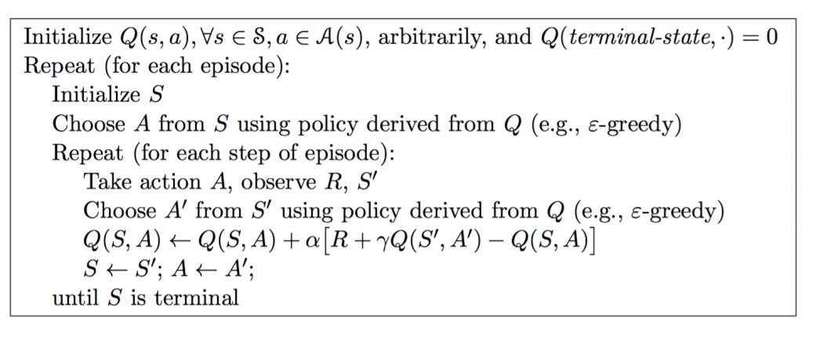
Sarsa Algorithm for On-Policy Control

Slide 47

Q-learning
As with TD, observe state s, reward r, take action a, observe next state s’
$$V_{π }(s)= \sum_{s^{′}∈S}{T\left(s,π(s),s^{′}\right)[R\left(s,π(s),s^{′}\right)+γV_{π}(s′)]}$$
$$V_{π}\left(s\right)←{(1−α)V}_{π}\left(s\right)+α(r+γV_{π}\left(s^{′}\right))$$
Q-learning: estimate ${ Q}_{∗}\left(s,a\right)$
$$Q_{∗}\left(s,a\right)=\sum_{s′∈S}{T\left(s,a,s^{′}\right)[R\left(s,a,s^{′}\right)+γ\max_{a^{′}∈A}{Q_{∗}\left(s′,a′\right)}]}$$
$${ Q}_{∗}\left(s,a\right)←(1−α){ Q}_{∗}\left(s,a\right)+α(r+γ\max_{a^{′}∈A}{Q_{∗}\left(s′,a′\right)})$$
$${ Q}_{∗}\left(s,a\right)←{ Q}_{∗}\left(s,a\right)+α(r+γ\max_{a^{′}∈A}{Q_{∗}\left(s′,a′\right)−{ Q}_{∗}\left(s,a\right)})$$
Will converge to ${ Q}_{∗}\left(s,a\right)$ given enough samples of each state-action pair

Slide 48
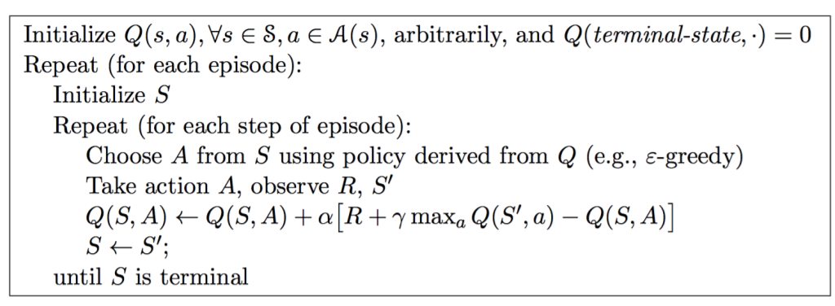
Q-Learning Algorithm for Off-Policy Control

Slide 49
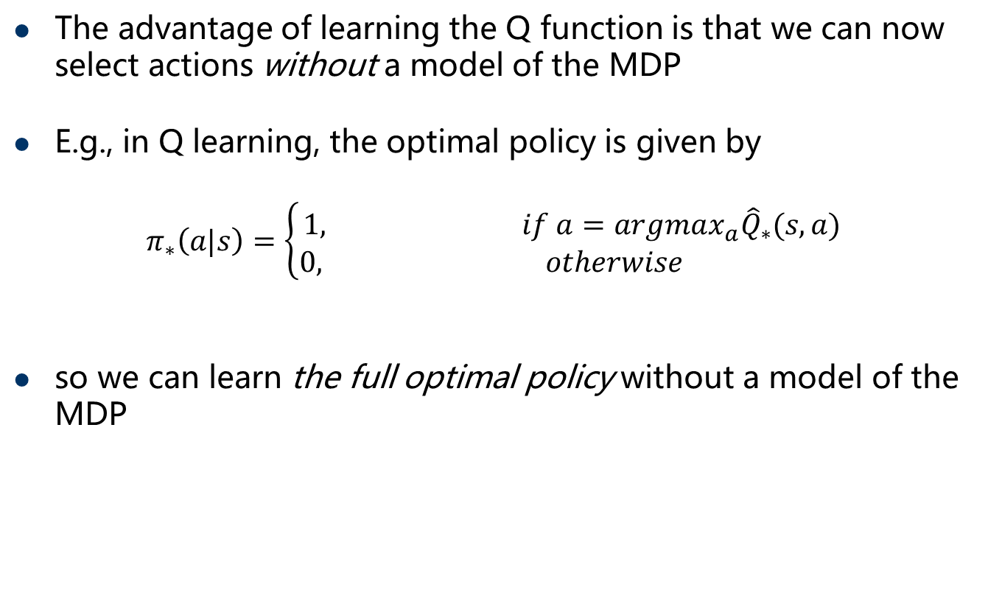
Benefits of Q function learning
The advantage of learning the Q function is that we can now select actions without a model of the MDP
E.g., in Q learning, the optimal policy is given by
$$π_{∗}\left(a|s\right)=\left\{\begin{aligned}1, if a=argmax_{a}{\hat{Q}}_{∗}(s,a) \\ 0, otherwise \end{aligned}\right.$$
so we can learn the full optimal policy without a model of the MDP

Slide 50
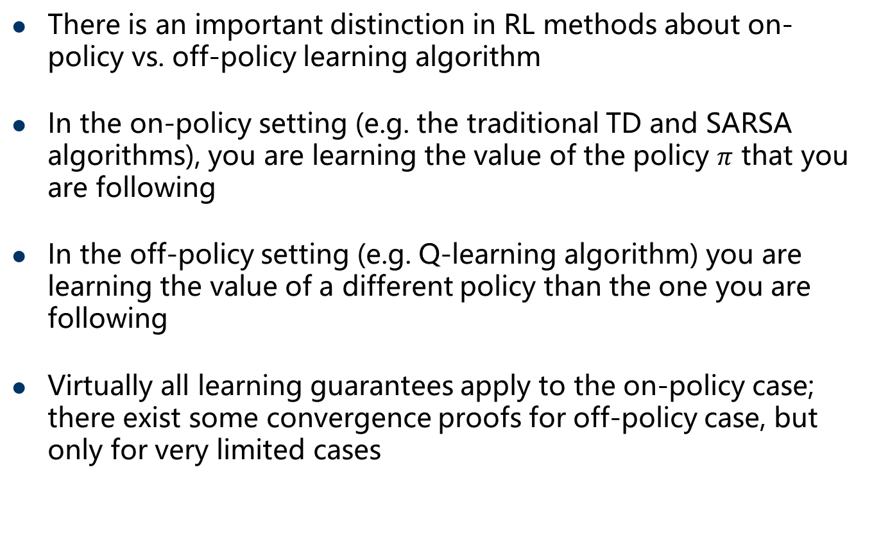
on-policy vs. off-policy learning
There is an important distinction in RL methods about on-policy vs. off-policy learning algorithm
In the on-policy setting (e.g. the traditional TD and SARSA algorithms), you are learning the value of the policy $π$ that you are following
In the off-policy setting (e.g. Q-learning algorithm) you are learning the value of a different policy than the one you are following
Virtually all learning guarantees apply to the on-policy case; there exist some convergence proofs for off-policy case, but only for very limited cases

Slide 51
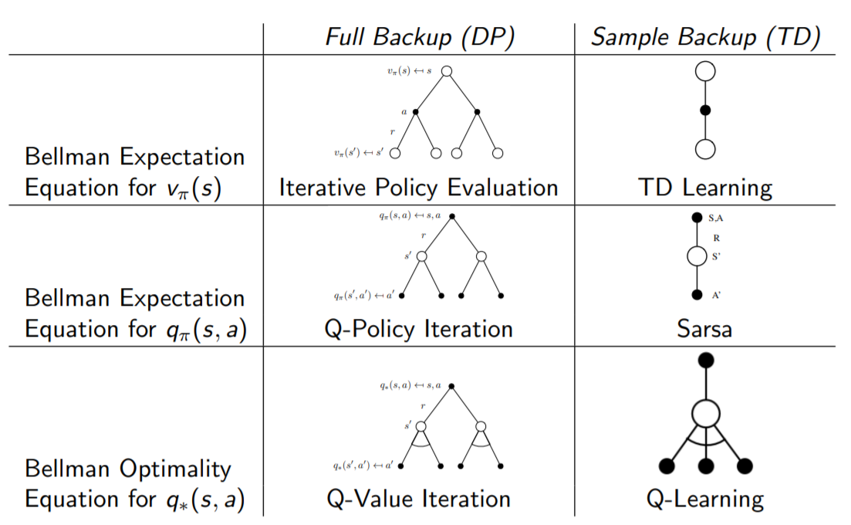
Relationship Between DP and TD
David Silver: www0.cs.ucl.ac.uk/staff/d.silver/web/Teaching_files/control.pdf

Slide 52
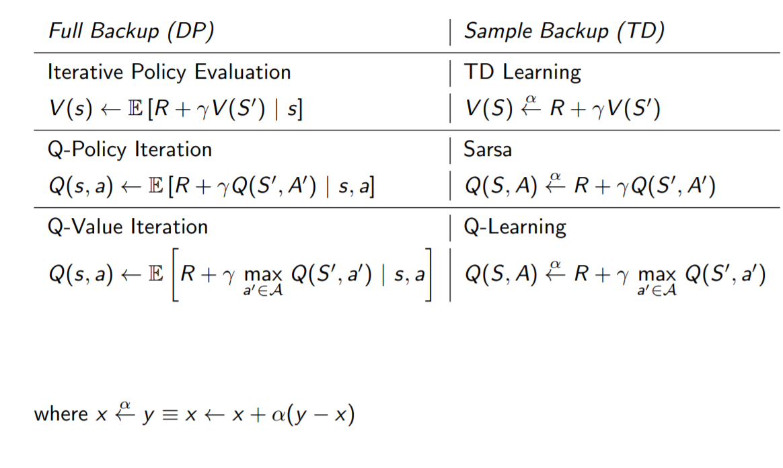
Relationship Between DP and TD
David Silver: www0.cs.ucl.ac.uk/staff/d.silver/web/Teaching_files/control.pdf

Slide 53
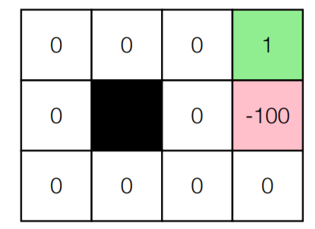
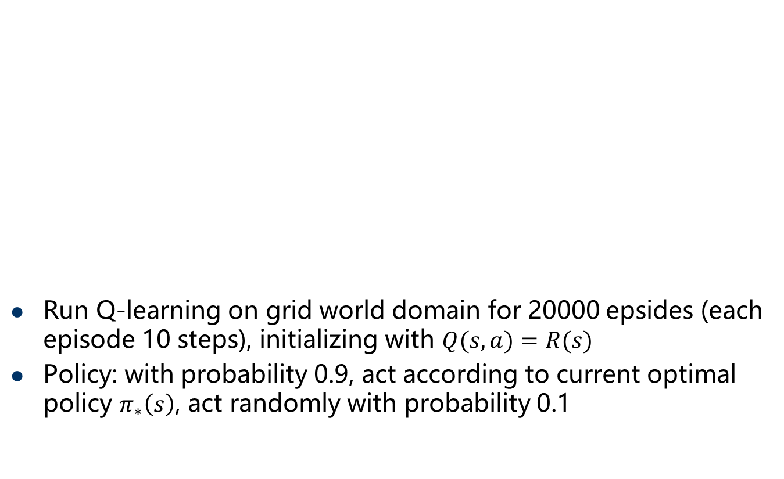
Q-learning experiment
Run Q-learning on grid world domain for 20000 epsides (each episode 10 steps), initializing with $Q(s,a)=R(s)$
Policy: with probability 0.9, act according to current optimal policy $π_{∗}\left(s\right)$, act randomly with probability 0.1

Slide 54


Q-learning progress
Optimal Q function estimation error of Q-learning for different $α$

Slide 55
Exploration/exploitation problem
All the methods discussed so far had some condition like “assuming we visit each state enough”, or “taking actions according to some policy”
A fundamental question: if we don’t know the system dynamics, should we take exploratory actions that will give us more information, or exploit current knowledge to perform as best we can?
Example: a model-based procedure that does not work
Use all past experience to build models T and R
Find optimal policy for MDP using e.g. value iteration and act according to this policy
Initial bad estimates may lead policy into sub-optimal region, and never explores further

Slide 56

Exploration in RL
Key idea: instead of acting according to the “best” policy based upon the current MDP estimate, act according to a policy that will explore less visited state-action pairs until we get a “good estimate”
Epsilon-greedy policy
$$π_{θ}\left(a|s\right)=\left\{\begin{aligned}\max_{a∈A}\hat{Q}\left(s,a\right) with probability 1−ε \\ random action otherwise\end{aligned}\right.$$
Boltzmann policy
$$π_{θ}\left(a|s\right)=\frac{\exp{(τ\hat{Q}\left(s,a\right))}}{\sum_{a^{′}∈A}{\exp{(τ\hat{Q}\left(s,a′\right))}}}$$
decrease$ε$, increase $τ$ to see more examples

Slide 57


Q-learning exploration illustration
Grid world but with random [0,1] rewards instead of rewards above
Initialize Q function with $\hat{Q}\left(s,a\right)=0$
Run with $α=0.05, ε=0.1, ε=0\left(greedy\right), ε=\frac{1}{n{\left(s\right)}^{0.5}}$, where $n(s)$ is the number of times we have visited state $s$

Slide 58

Accuracy of Q function approximation
Error in Q function estimation for different exploration strategies

Slide 59

Average attained reward
Average per-episode reward attained by different exploration strategies

Slide 60

Large state space
Can not use simple discrete MDPs
Linear value function approximation:
define features $φ\left(s,a\right)$ and weights $w$
$$Q_{∗}\left(s,a;w\right)=w⋅φ(s,a)$$
all states with similar features will have similar Q-values
Q-learning with linear function approximation
on each $(s,a,r,s′)$
$$w←w+α[r+γ\max_{a^{′}∈A}{Q_{∗}\left(s^{′},a^{′};w\right)−{ Q}_{∗}\left(s,a;w\right)}]φ(s,a)$$
Implied objective function:
$${\frac{1}{2}[Q}_{∗}\left(s,a;w\right)−{(r+γ\max_{a^{′}∈A}{Q_{∗}\left(s^{′},a^{′};w\right)})]}^{2}$$

Slide 61






Large state space
Q-learning with deep network as Q function approximator
$Q_{∗}\left(s,a;θ\right)=f(s,a;θ)$, how to update $θ$？
linear function approximation
deep networks approximation
$$Q_{∗}\left(s,a;w\right)=w⋅φ(s,a)$$
$Q_{∗}\left(s,a;θ\right)=f(s,a;θ)$
$${\frac{1}{2}[Q}_{∗}\left(s,a;w\right)−{(r+γ\max_{a^{′}∈A}{Q_{∗}\left(s^{′},a^{′};w\right)})]}^{2}$$
$$?$$
$$w←w+α[r+γ\max_{a^{′}∈A}{Q_{∗}\left(s^{′},a^{′};w\right)−{ Q}_{∗}\left(s,a;w\right)}]φ(s,a)$$
$$?$$
Deep Q Network (DQN)：Mnih et al., “Human-level control through deep reinforcement learning”, Nature 2015

Slide 62

DQN: a few additional tricks
keep Q function fixed and only update every C iterations
keep replay buffer of past actions
convolutional network takes pixel images as input (actual pixel images from past four frames), outputs Q function
Same exact method applied to 50 Atari games, exceeds human performance in most cases

Slide 63
Summary
Data-driven planning
Model-based RL
Value-based RL
Policy-based RL
which approach best suits me
Model-based: if you are data-poor, and/or have a real system you can’t afford to break 100 times while training
Value-based: Problem looking a bit more “planning-like” ideally with small numbers of actions
Policy-based: Relatively simple “reactive” policies could work well, but potentially high dimensional control space

